Slide 1
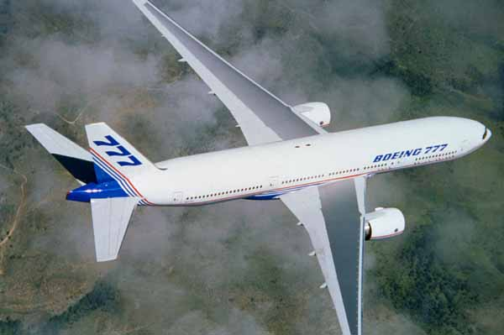
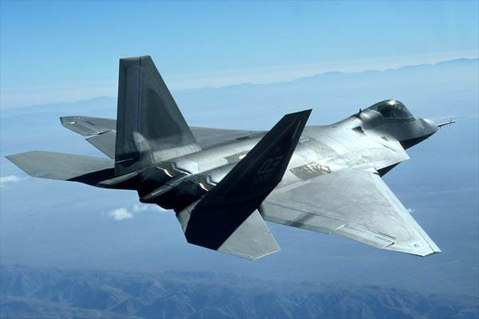
Aspect Ratio.
At high transonic or supersonic
speeds, wings with low aspect
ratio are used.
At low transonic speeds,
wings with high aspect
ratio can be used.

Slide 2
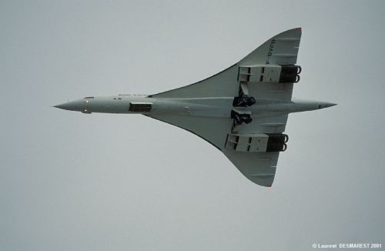
Delta wing
Concorde has a very high
M_{crit} and very low
transonic drag
Notes:
‹#›
At all speeds, a high aspect ratio is required in order to keep the induced drag low. But at high speeds, the additional wave drag causes the designer to make the wing airfoil section as thin as possible. This requires a heavy structure to withstand the bending forces of wings with high aspect ratio. Therefore, in order to reduce the weight, the aspect ratio of the wings must be limited on aircraft designed for high transonic or supersonic speeds.

Slide 3
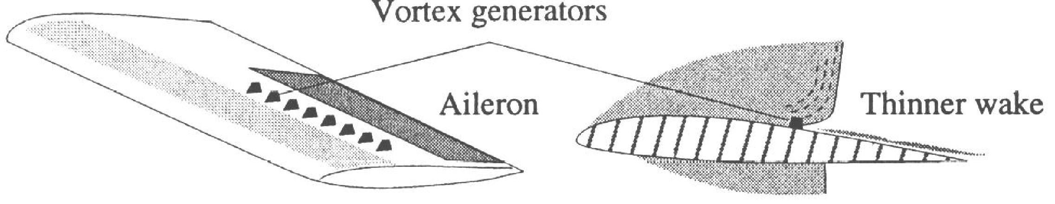
Vortex generators.
Notes:
‹#›
An example of a wing with a very low aspect ratio is the so-called delta wing. This plan form with a very high angle of sweep at the leading edge gives a low thickness/chord ratio despite a rather thick wing root. It creates relatively low wave drag and has very positive characteristics at transonic and supersonic speeds.
However, at low subsonic speed it requires a greater angle of attack than a swept wing for a given lift, creating very high-induced drag.
The delta wing has low transonic drag and good characteristics at transonic and supersonic speeds, but it has very high induced drag at low speeds.

Slide 4
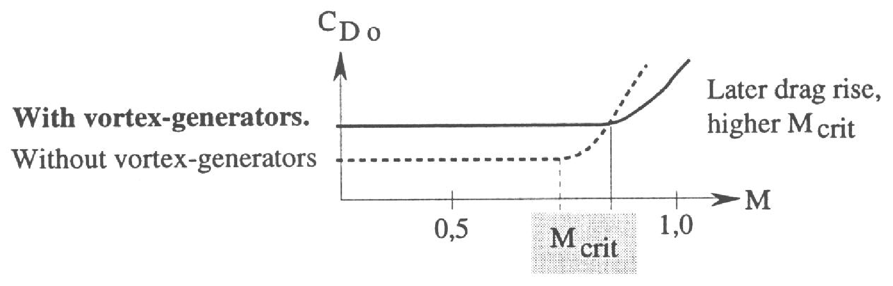
Vortex generators (cont).
Notes:
‹#›
Vortex generators may be used at all speeds but for different reasons. If the design features such as thin, or supercritical wing sections are not sufficient to allow the aircraft to reach the desired critical Mach number, the designer may add so-called vortex generators in some critical areas such as in front of the ailerons.
The vortex generators re energise the boundary layer by pulling fresh air from the region above the boundary layer down to the slower flowing boundary layer. In this way the vortex generators distribute the development of shockwaves to a longer chord, reducing the effect of the boundary layer separation.

Slide 5
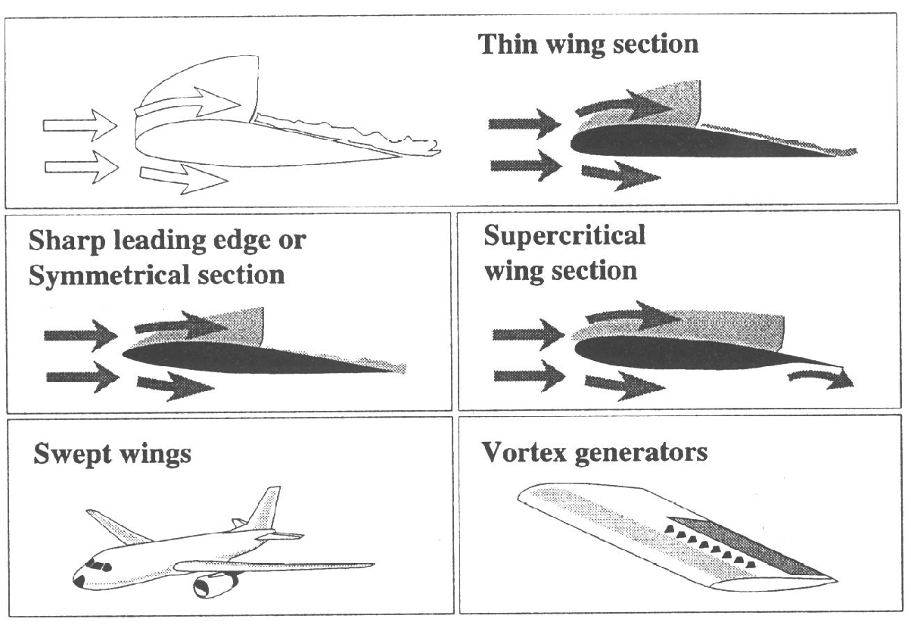
Summary
Notes:
‹#›
The vortex generators distribute the development of the shockwaves to a longer chord, reducing the effect on the boundary layer separation. They increase drag at subsonic speeds, but reduce drag at transonic speeds.

Slide 6
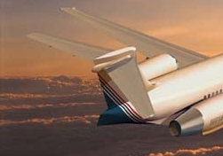
The tailplane.
Notes:
‹#›
In order to increase the critical Mach number or to minimise its adverse effects, these design features or a combination of them may be used.

Slide 7
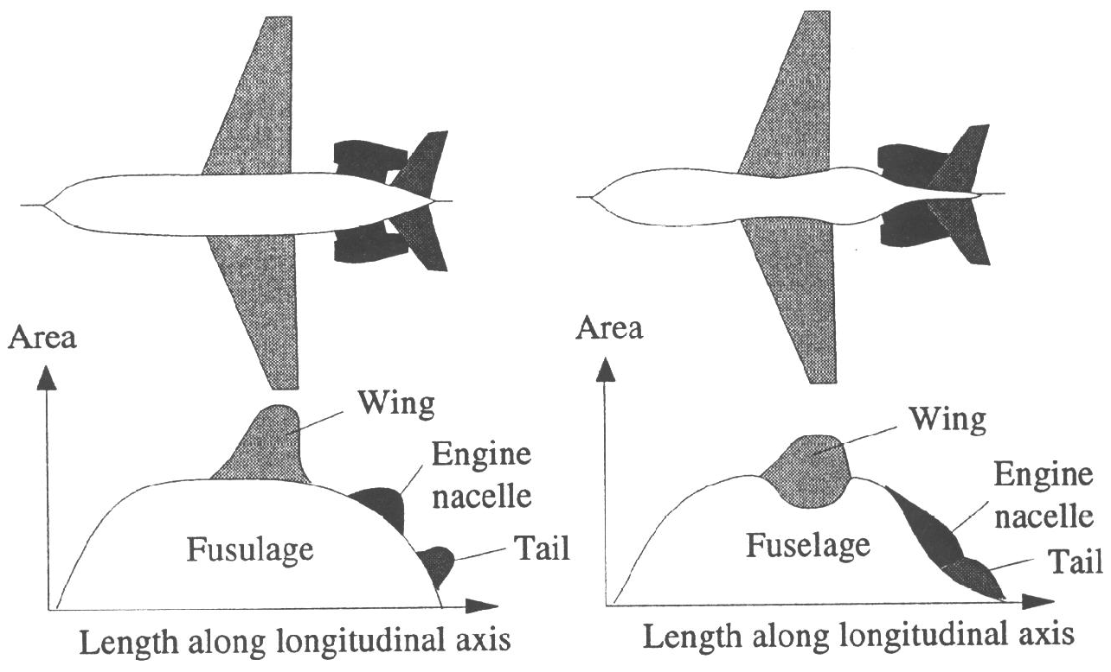
Wave drag and area rule.
Notes:
‹#›
The tailplane behaves in a manner very similar to the wing. The shock drag must be kept low by using thin tails, fairly sharp leading edges and sweepback.
It is important from the control point of view to avoid formation of shocks waves on the tail since they result in loss of elevator effectiveness. The tail is therefore designed to have a higher critical Mach number than the wing.

Slide 8
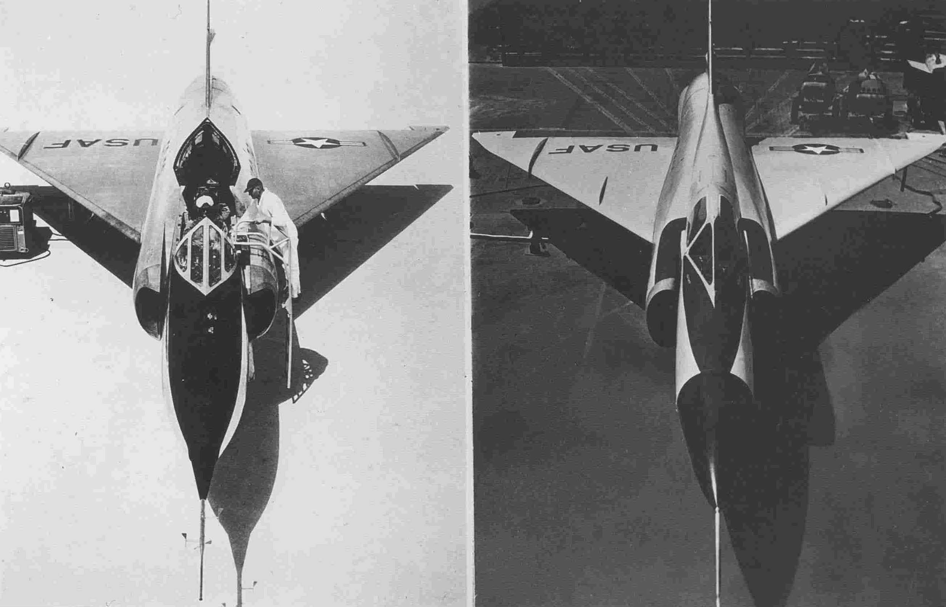
Wave drag and area rule.
BEFORE
AFTER
Notes:
‹#›
In any aircraft configuration, in general, there is an extra amount of drag due to the fact that the shockwave from one component of the aircraft can cause flow separation on another.
This wave drag can be minimised at transonic speeds by ensuring that the distribution of its total cross-sectional area follows a smooth path along the length of the axis of the aircraft. This optimised cross-section distribution is called the transonic area rule.
This diagram shows the cross-section area distribution of a "traditional" aircraft design, to the left, and of an aircraft according to the "area-rule", to the right.
The "area rule" minimises wave drag at transonic and super-sonic speeds by ensuring that the total cross-sectional area of the aircraft follows a smooth path.

Slide 9
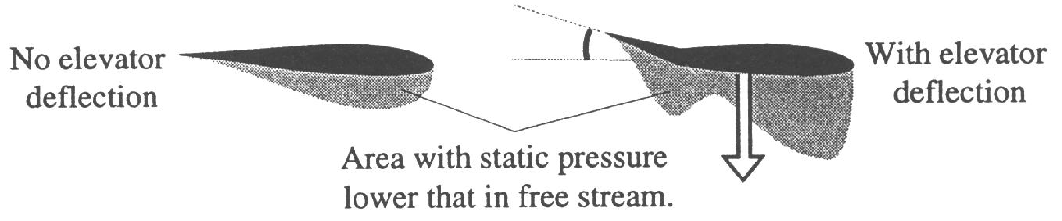
Reduced elevator effectiveness

Slide 10
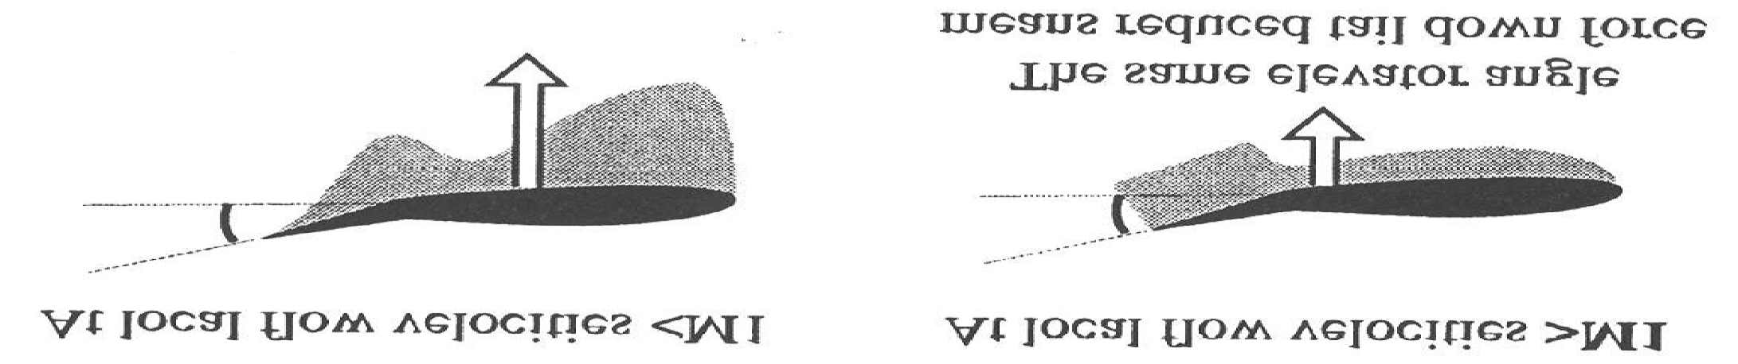
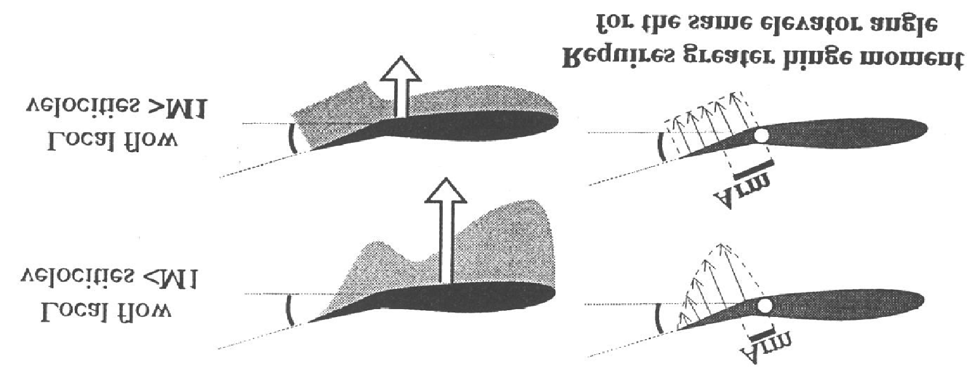
Reduced elevator effectiveness
Notes:
‹#›
Shock induced flow separation at the tail may result in a significant reduction of elevator effectiveness.
Let us take a closer look at what happens with the elevator. As mentioned earlier, the pressure distribution is quite different on an airfoil at transonic or supersonic flow velocities than when having a pure subsonic velocity. At subsonic velocity over the tail, the deflection of the elevator changes the pressure distribution and so the lift of the whole unit by transmitting pressure waves ahead.

Slide 11
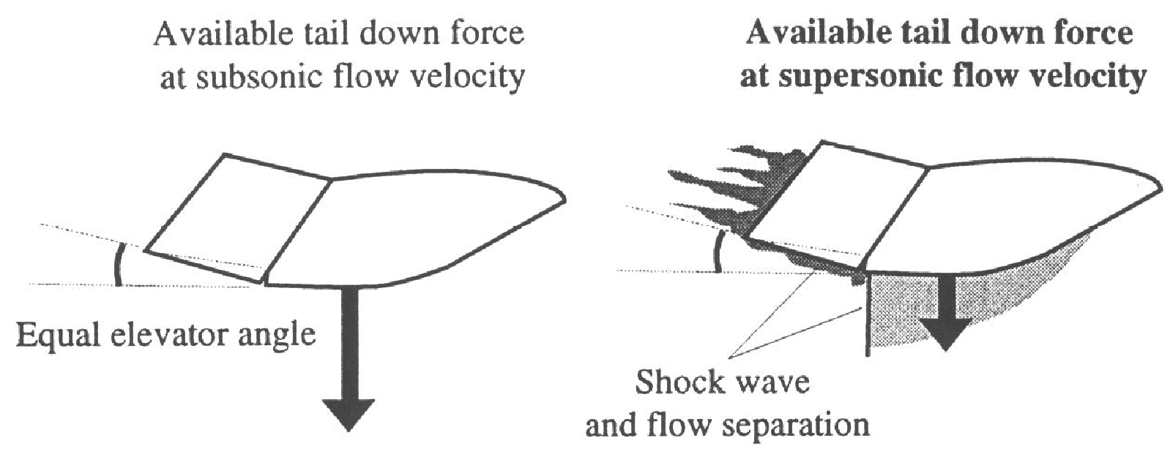
Reduced elevator effectiveness
Notes:
‹#›
However, when flying at high transonic or supersonic speeds, the flow in front of the elevator does not "feel" the changes in pressure caused by the elevator deflection. The pressure distribution in front of the elevator is therefore not changed so the total effect of an elevator deflection is much smaller at supersonic than at subsonic velocities.
The reduced effectiveness of the control surface requires a large increase in the angle of the control surface to obtain the increased trim force.
Another effect of supersonic flow around the control surfaces is that the centre of pressure of the control surface moves aft due to the change from approximately triangular to rectangular pressure distribution. The centre of pressure is moved to half the chord of the surface in supersonic flow.
Thus there is a difficult combination of a control force heavier than normal which simultaneously needs a deflection much greater than normal!

Slide 12
Summary
Reduced effectiveness of the control surfaces requires a large increase in the control surface angle.
When there is supersonic flow over a surface, the centre of pressure is moved near half the chord of that surface.
The aft moment of the resultant force on the control surface increases the required moment and the stick force needed to deflect the surface to a certain angle.
The stick force required to trim or manoeuvre an aircraft at high transonic or supersonic speeds may get out of hand.
A pull-out from a transonic dive may be very difficult to perform for aircraft designed for subsonic speeds only.
Notes:
‹#›
When flying into high transonic speed, shock induced flow separation on the horizontal tail surfaces would dramatically reduce the available tail down force; in the most severe cases possibly leading to an uncontrolled dive. This should not happen until above M_{MO}.

Slide 13
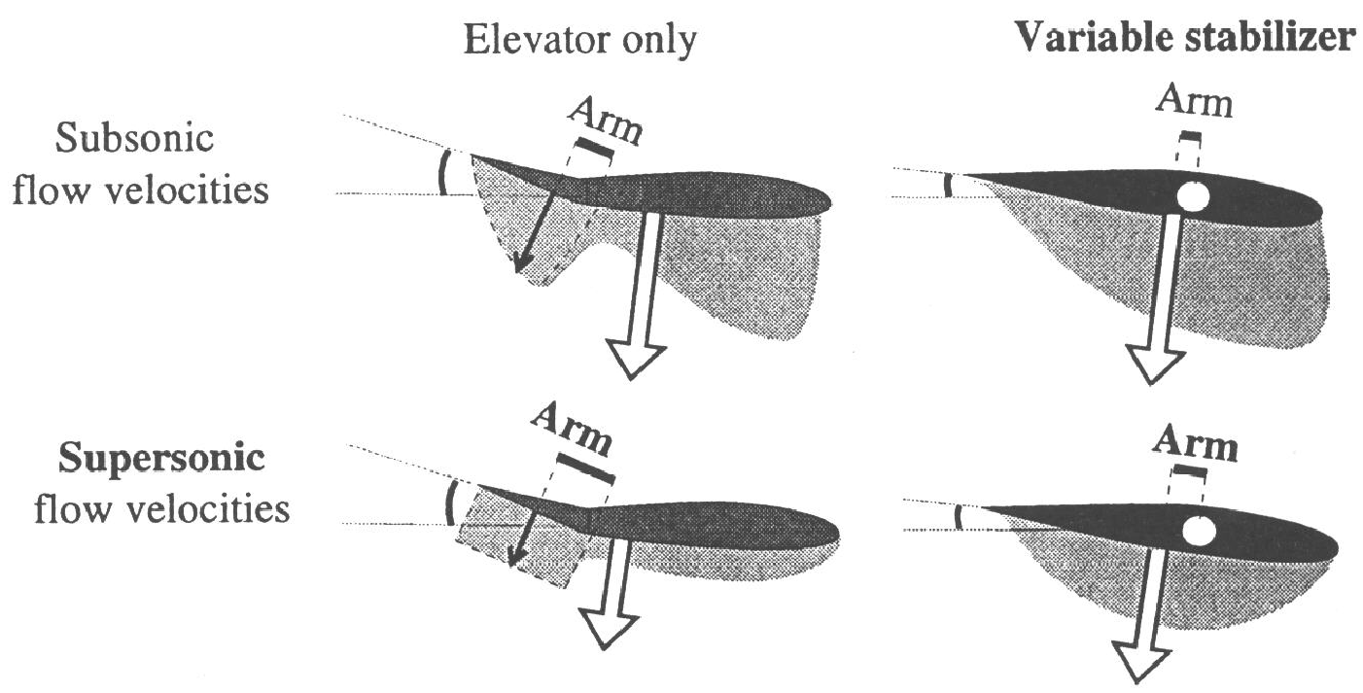
Use of a variable incidence stabiliser.
Notes:
‹#›
NOTE!
The effect of an elevator deflection is much smaller at supersonic than subsonic velocities.
Reduced effectiveness of the control surfaces requires a large increase in the control surface angle.
When there is supersonic flow over a surface, the centre of pressure is moved near half the chord of that surface.
The aft moment of the resultant force on the control surface increases the required moment and the stick force needed to deflect the surface to a certain angle.
The stick force required to trim or manoeuvre an aircraft at high transonic or supersonic speeds may get out of hand.
A pull-out from a transonic dive may be very difficult to perform for aircraft designed for subsonic speeds only.

Slide 14
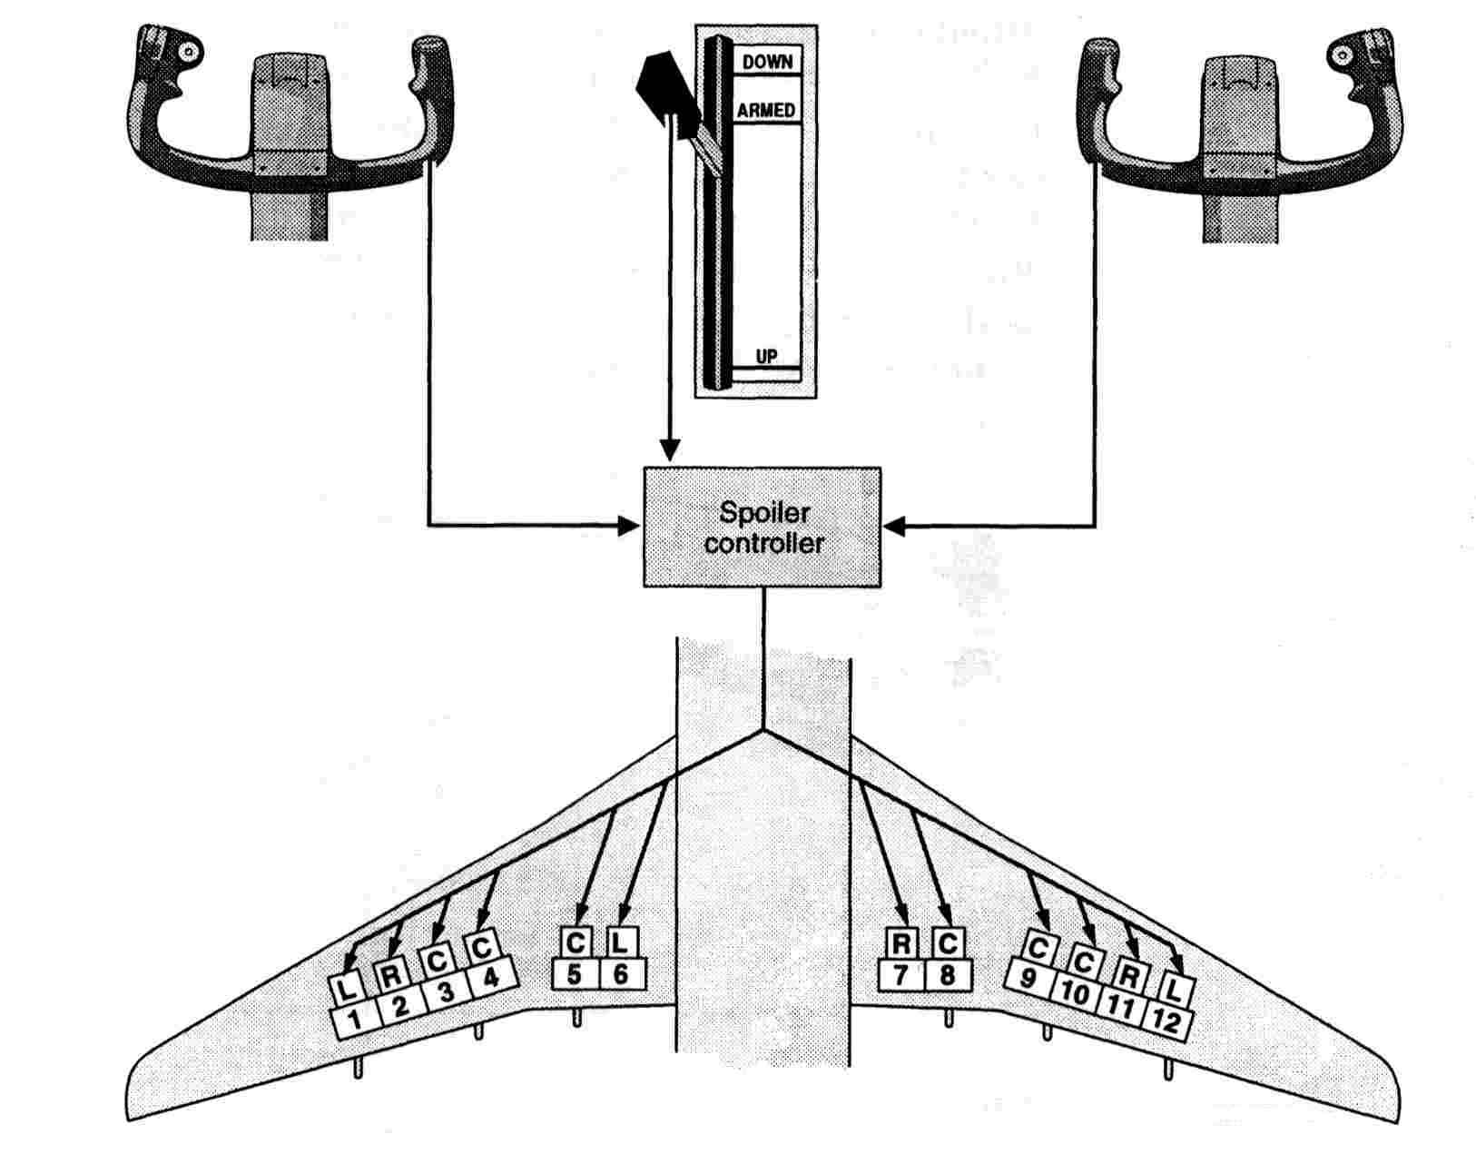
Lateral control problems
Spoilerons
Notes:
‹#›
One way of improving the pitch control is to a pitch trim which rotates the whole stabiliser. The force downward will be greater at a lower angle.
Aircraft designed for flight in the high transonic speed range will employ some form of variable incidence stabiliser. While aircraft designed to fly in the supersonic speed range will generally employ all moving tail planes or stabilators.

Slide 15
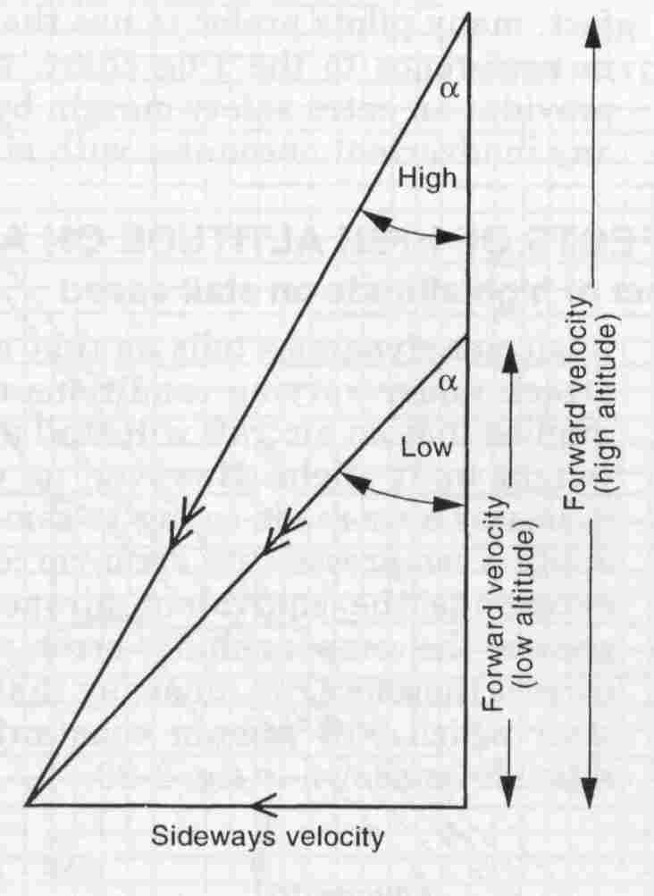
High altitude stability
Directional stability decreased
Longitudinal stability decreased
Lateral stability unchanged
Spiral stability increased

Slide 16
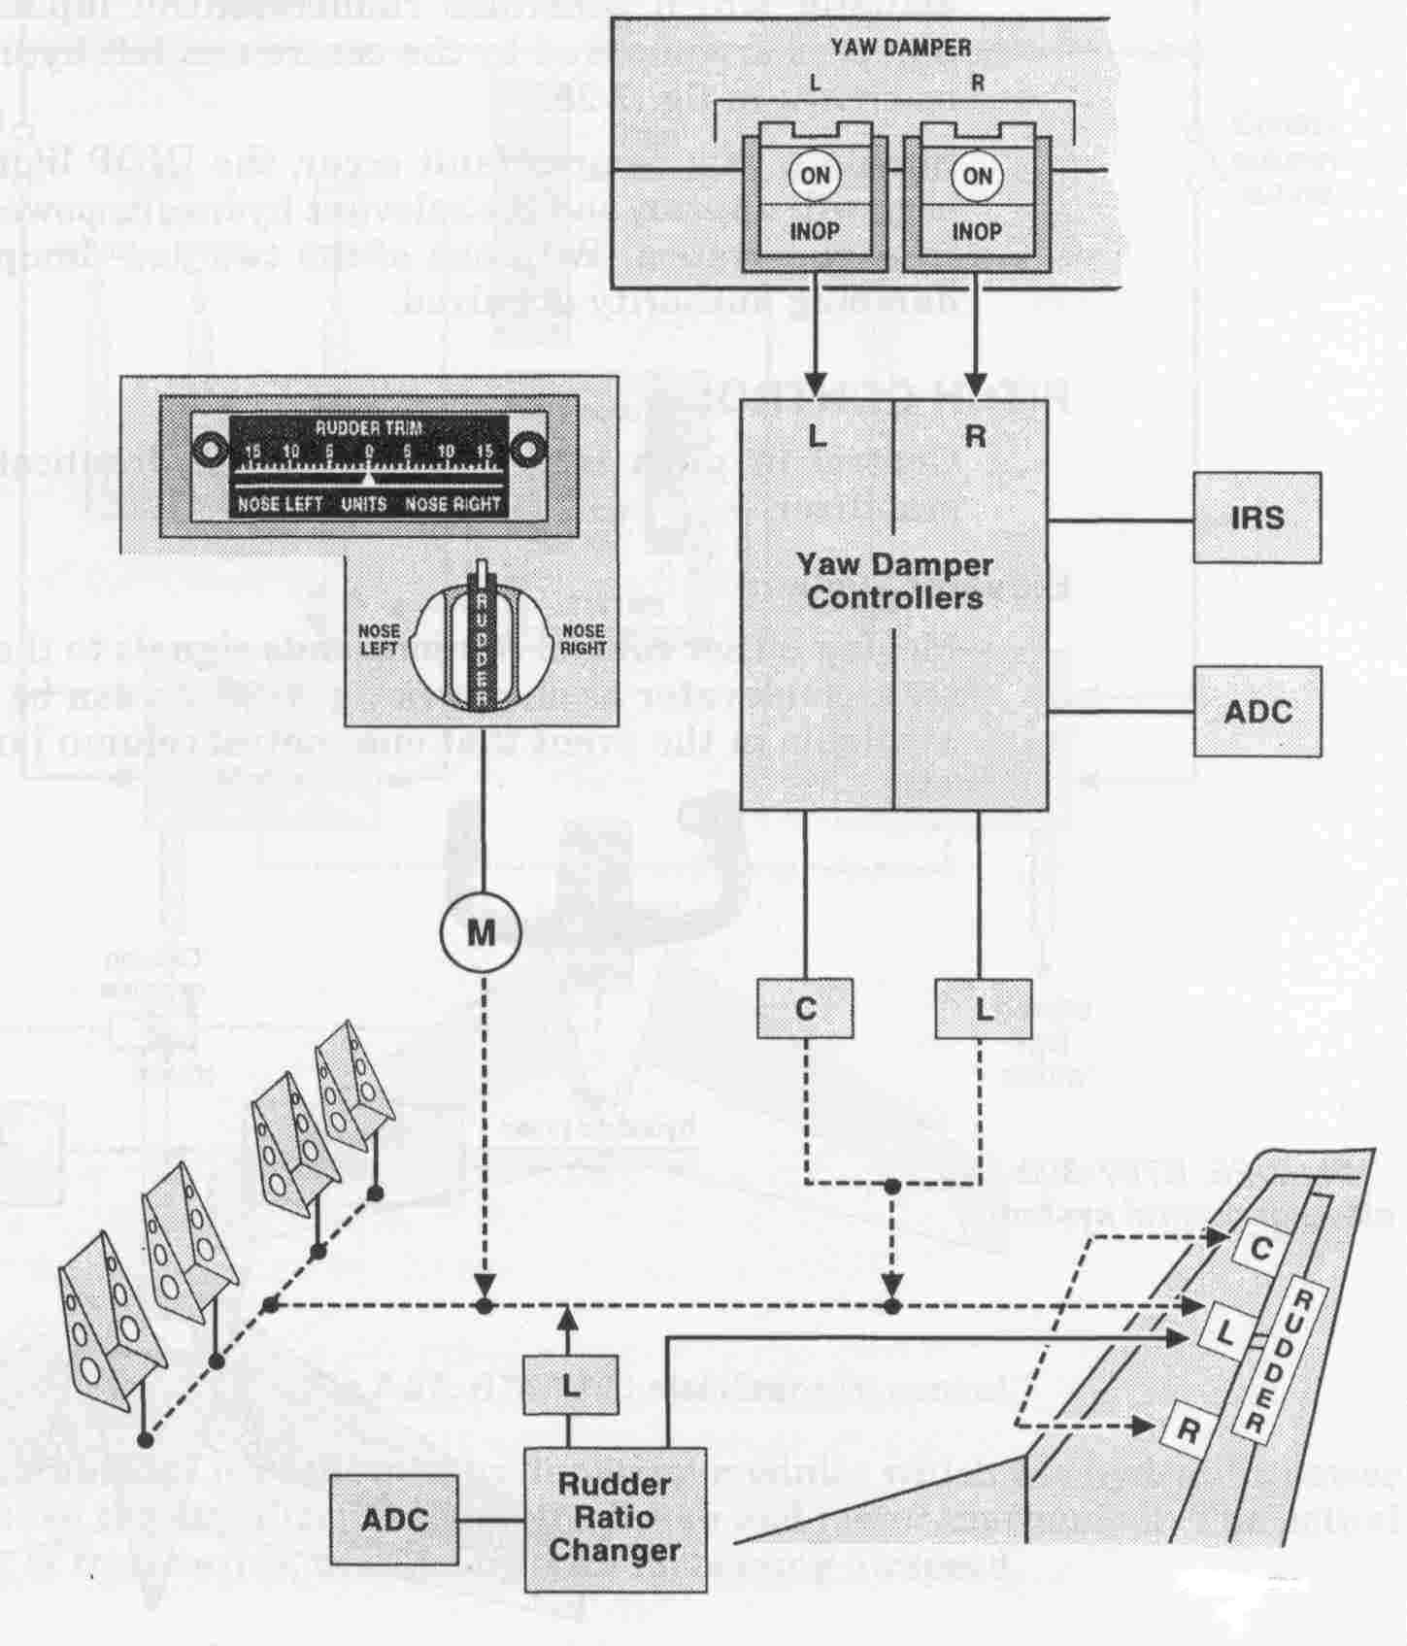
Yaw dampers
Notes:
‹#›
The tendency of an aircraft to return to an original trimmed state after being upset is an indication of positive stability.
In the case of the yawing plane the vertical fin is subject to an angle of attack from one side such that a restoring force is produced, opposing the initial yaw. The size of the force will depend on the speed of the aircraft and the angle of attack. At high altitude, where for a given EAS the aircraft has a notably higher TAS, the angle of attack on the fin will be less than for the same yaw at a low altitude. Thus the restoring force is reduced at altitude even though the EAS is unchanged. This effect is also noticeable in the longitudinal or pitching plane. Lateral stability in the rolling plane is largely unchanged (although roll damping is reduced) because the effect acts equal and opposite on each wing simultaneously.
A high level of spiral stability produces a high predisposition to “dutch roll”; which is the result of high lateral stability associated with low directional stability. At high altitude, for a given EAS there is little or no change in lateral stability, coupled with decreased directional stability.
An increase in spiral stability means an increased predisposition to “dutch roll”.

Slide 17

Inertia and turning performance
V²
g Tan φ
Turn radius, r (ft) =
V
r
Turn rate, (radians/sec) =
V
(TAS ft/sec)
g
Φ (Bank angle)

Slide 18
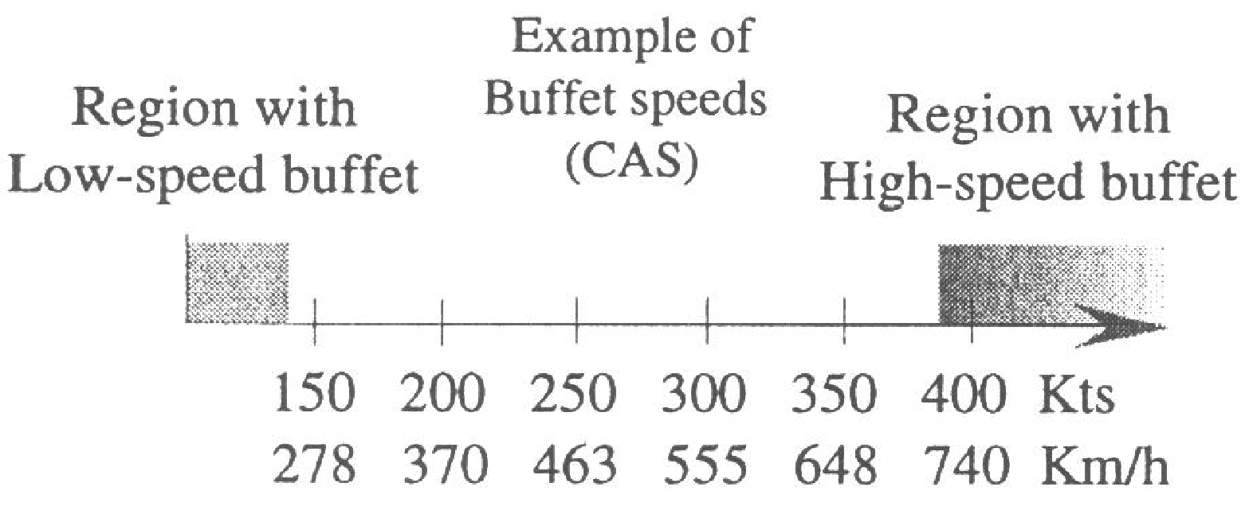
The speed envelope
Notes:
‹#›
Dutch roll is a yawing, rolling, oscillatory motion which is apparent to some degree on most high speed, high altitude aircraft. Mitigation of dutch roll depends largely upon serviceable yaw dampers.
In simple terms a yaw damper employs a rate gyro to detect any directional divergence due to the onset of dutch roll, and correct it through hydraulic actuators to the rudder placed in parallel with the pilot’s rudder pedals.
Here is a typical yaw damper installation as fitted to a B767.
This system makes it possible to artificially enhance the directional, and therefore oscillatory stability of an aircraft.

Slide 19
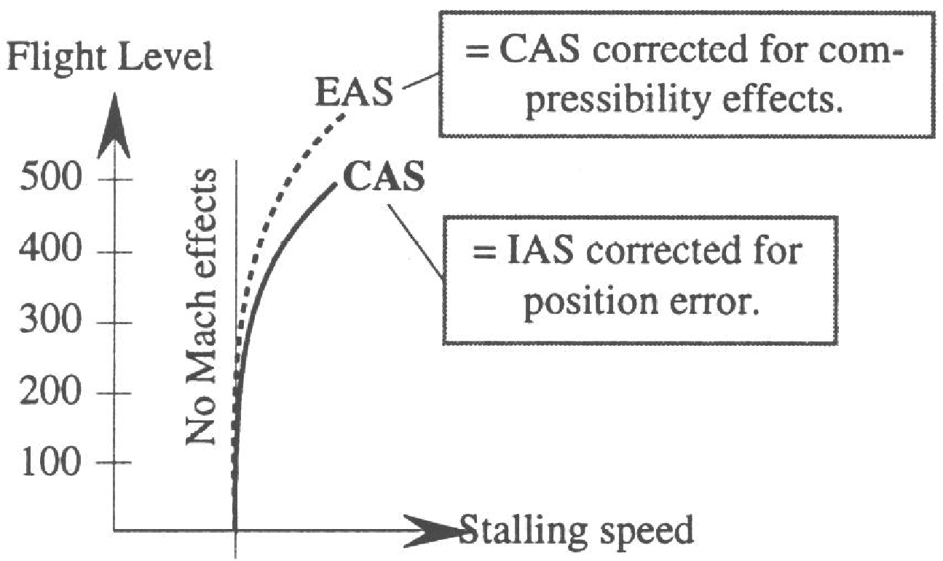
The speed envelope (cont).
Notes:
‹#›
As a general rule, operations at high altitude involve a large increase in TAS compared to sea level values. With this increase in TAS, the aircraft has increased momentum and kinetic energy, both of which make the aircraft resistant to a change in flight path. Simply the aircraft is less manoeuverable.
An aircraft maintaining a 30º bank turn at 250 KIAS at 2000’ AMSL would result in a turn radius of 10,500 feet or approximately 1.7 NM.
The same aircraft at FL410 at 250 KIAS (0.84 TMN or 480 KTAS) the turn radius would be 35,000 feet or 5.8 NM.
The increase in TAS when operating at high altitude also increases the risk of a stall if the aircraft is handled roughly. Because of the high TAS, a sudden change in pitch attitude will not be followed immediately by a change in flight path. The result of this is a sudden transitory increase in the angle of attack if the pitch attitude is increased suddenly: sometimes called an inertia stall.

Slide 20
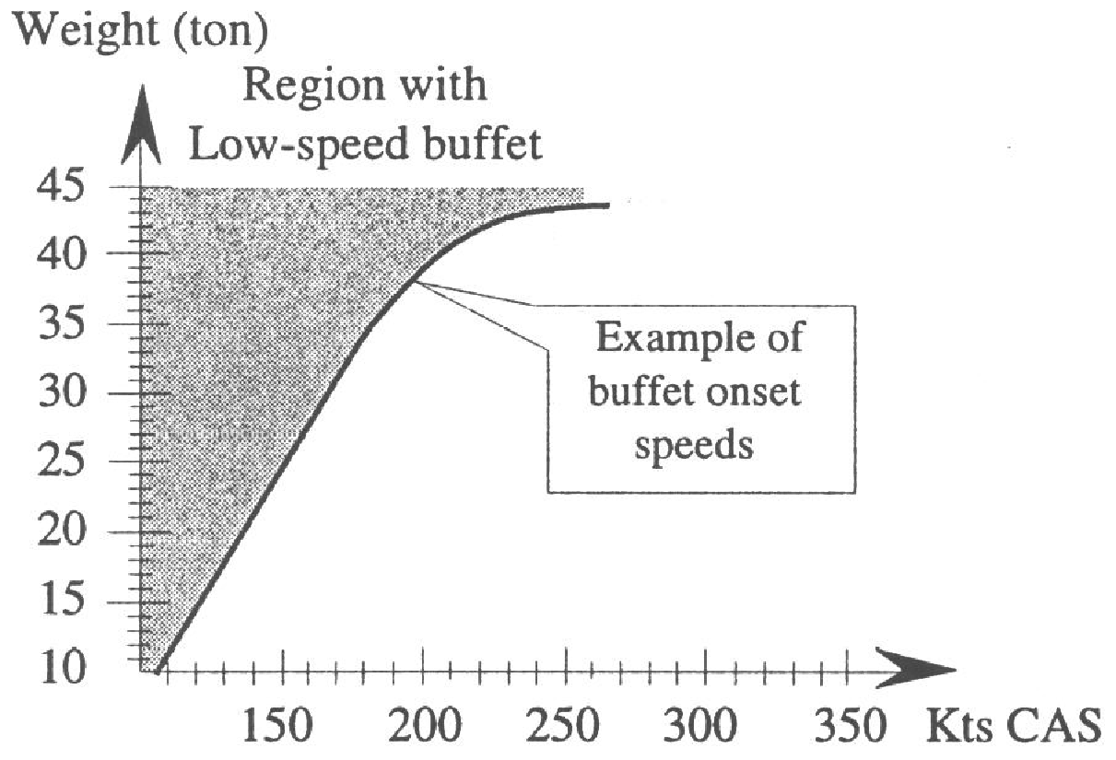
The speed envelope (cont).
Notes:
‹#›
The speed envelope, within which the aircraft can operate, is limited at the lower end by the stalling speed. At the upper end, the limit is set by the speed at which it structurally can withstand only a small vertical gust, or at which it starts to have problems with regard to controllability due to mach effects.
The lower limit is called low-speed buffet and the higher limit, due to mach effects, the high-speed buffet zone.

Slide 21
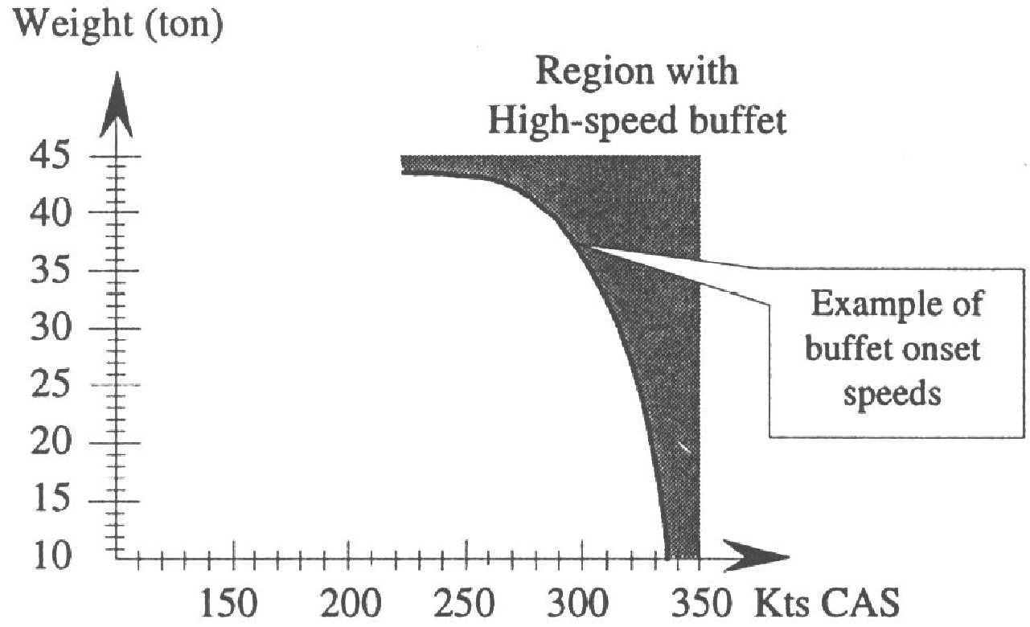
The speed envelope (cont).
Notes:
‹#›
Let us have a closer look at the calibrated stalling speed (V_{S} CAS).
The indicated stalling speed for general aviation aircraft is constant with altitude. But, because of the mach effects, this is not the case for an aircraft at high altitudes. The first mach effect has to do with the reduced CL max and the second with the compressibility error of the airspeed indicator. These two effects cause the indicated stalling speed to increase with altitude.
Stalling EAS remains relatively constant up to approximately FL300.

Slide 22
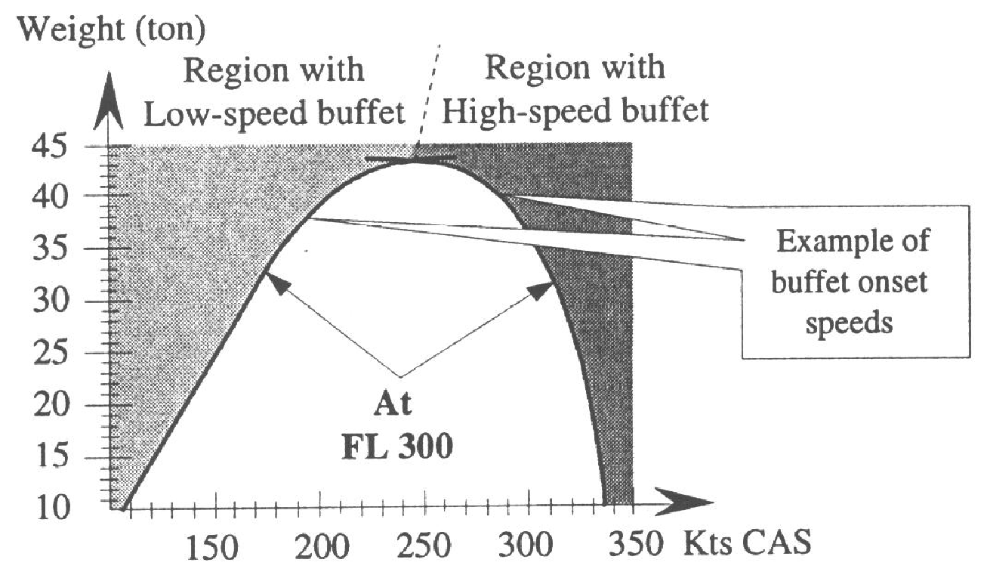
The speed envelope (cont).
Notes:
‹#›
The main factor affecting the buffet speeds is the weight, and/or the load factor, which has a great influence on these speeds. In the figure above there is an example of calibrated stalling speed in relation to weight.

Slide 23
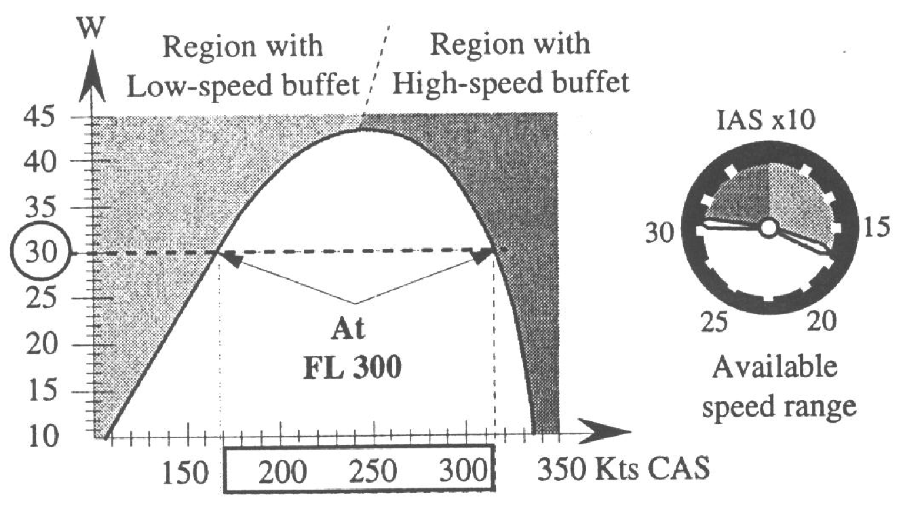
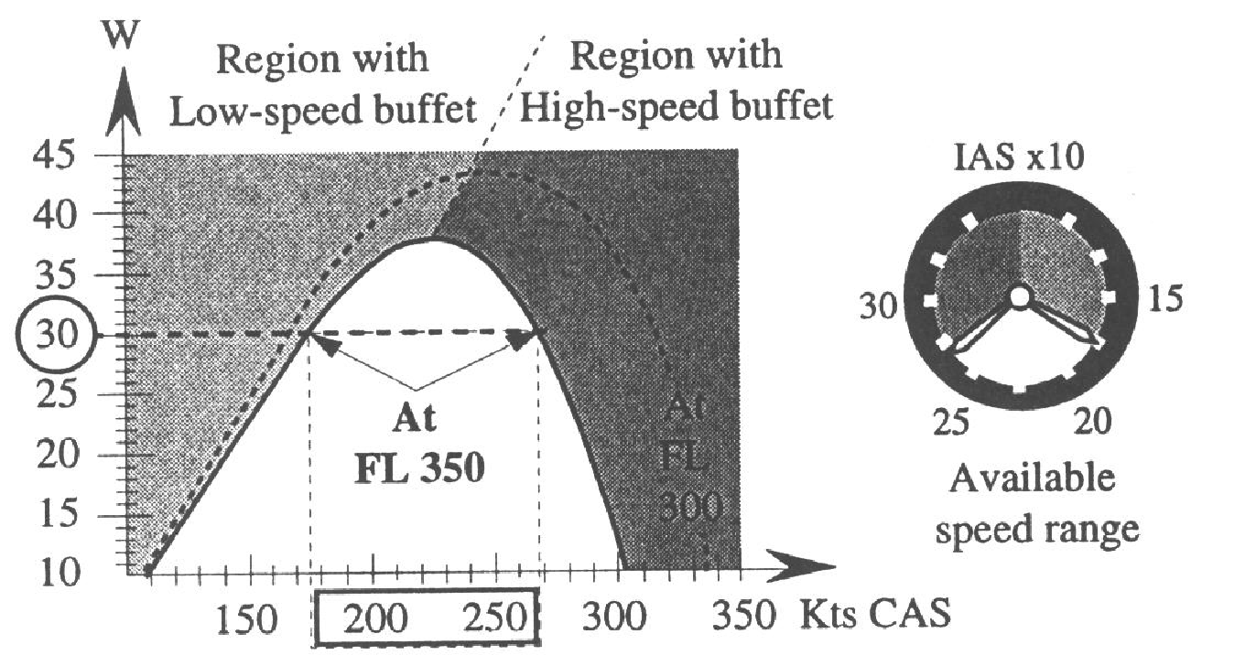
The speed envelope (cont).
FL300
AUW 30TONNES
SPEED RANGE 170-315 KCAS
MAX FLT AUW 43 TONNES
FL350
AUW 30 TONNES
SPEED RANGE 175-268 KCAS
MAX FLT AUW 38 TONNES
Notes:
‹#›
The limit of the high-speed buffet will instead decrease with increased weight. This occurs because the greater amount of lift causes higher local velocities over the wing and shockwaves at a lower speed.

Slide 24
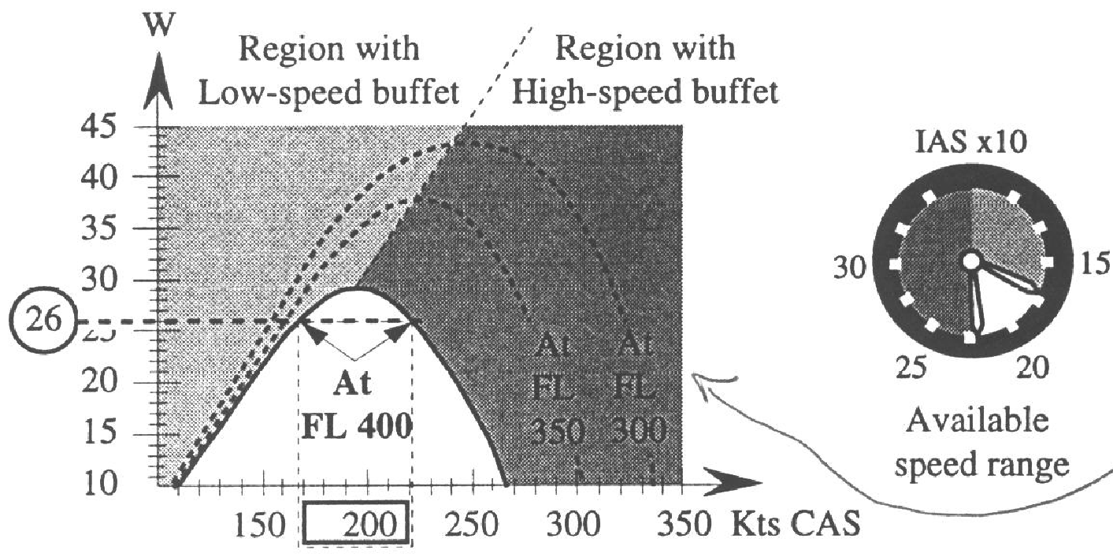
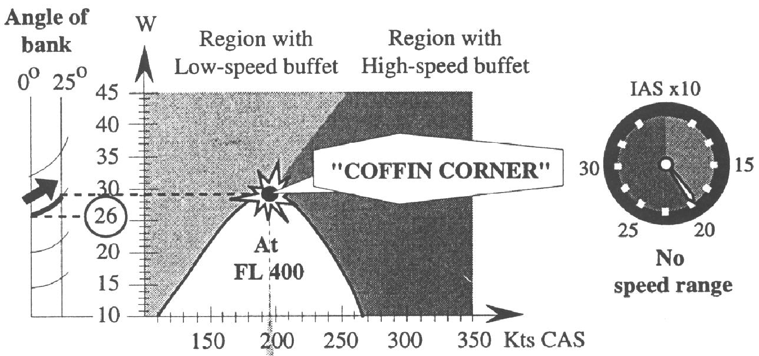
The speed envelope (cont).
FL400
AUW 26 TONNES
SPEED RANGE 168-220 KCAS
MAX FLT AUW 29 TONNES
NOW TURN THE AIRCRAFT USING 25º BANK
Notes:
‹#›
Since both the lower and the upper buffet speeds are influenced by the actual weight and the available power, we get a weight and speed envelope for a given altitude like this example.

Slide 25
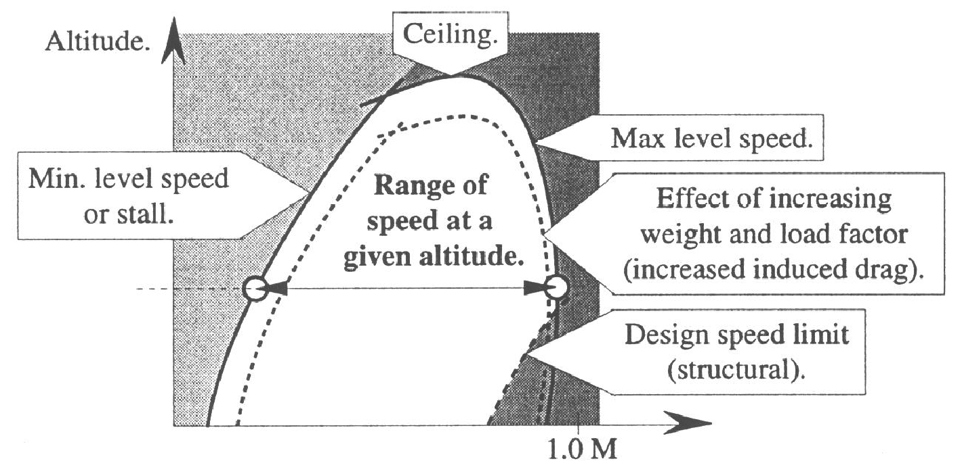
The speed envelope (cont).
Notes:
‹#›
As seen in the upper graph, at a gross weight of 30 tons and "standard" altitude of 30 000 ft, based on 1013 hPa and designated FL 300, safe flight can only be maintained at a speed between 170 and 315 knots calibrated airspeed. At speeds below or above these the aircraft will experience buffeting and may stall. Notice the max weight for flight due to lift limitations of approx. 43 tons.
At a higher altitude, for instance at FL 350, we will have a narrower speed envelope at 30 tons, and it is no longer possible to fly at a gross weight of above 38 tons.

Slide 26
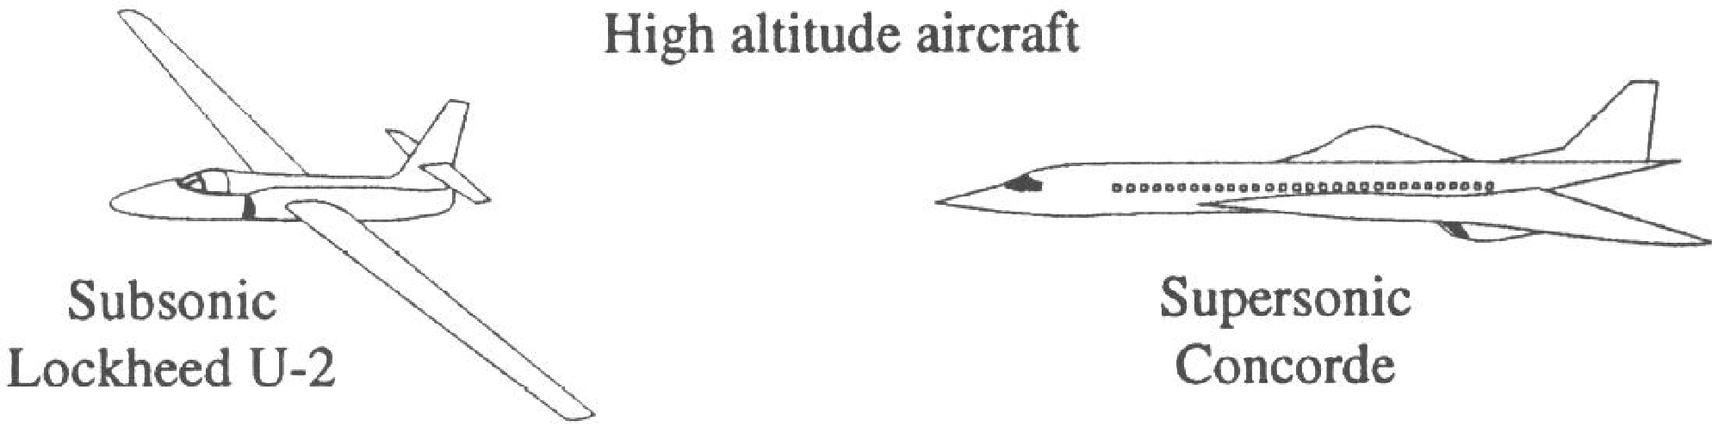
The speed envelope (cont).
Notes:
‹#›
At an even higher altitude, of 40 000 ft, the speed envelope is very narrow. With a gross weight of 26 tons, a small decrease in speed will put you into a low-speed buffet and a small increase in speed will put you into a high-speed buffet.
In these conditions, an increase in load factor caused by a vertical gust or by making a turn will put you, so to speak, to a point of no return.
With this combination of altitude, weight and available power, you will have low and high speed simultaneously and you will lose control of the aircraft. The point on the graph where your speed is too low and too high at the same time is called: "the coffin corner".

Slide 27
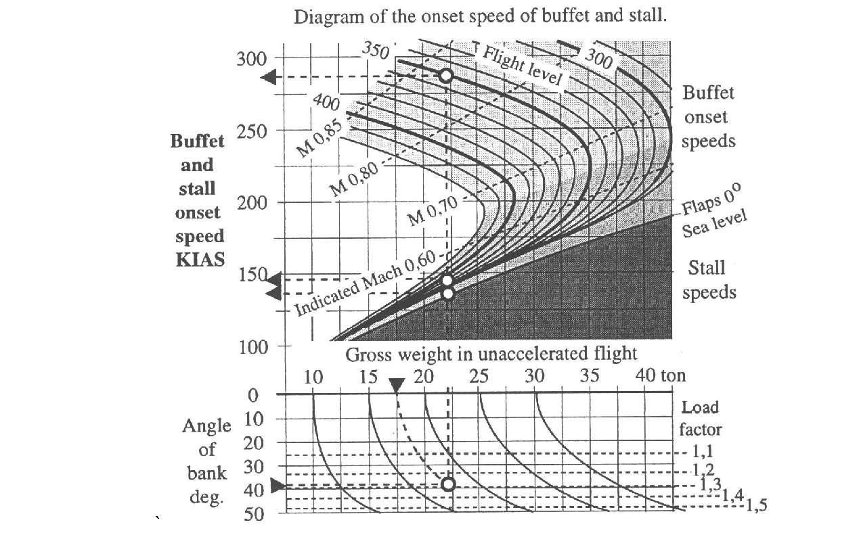
Buffet boundary diagram
Notes:
‹#›
Since all aircraft are able to fly only due to the speed relative to the air and since there is a lower and an upper speed limit, there will be a limited speed and altitude envelope where level flight at a constant speed can be maintained.

Slide 28
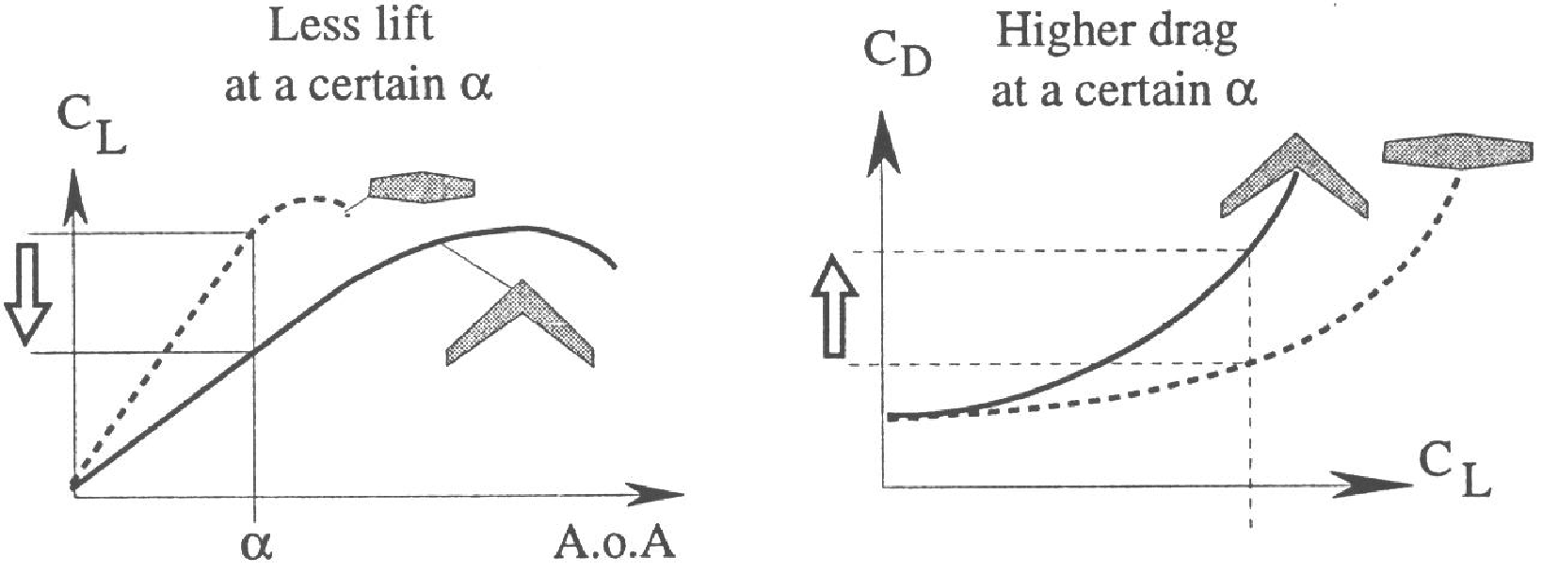
Disadvantages of swept wings. Lift/drag.
Notes:
‹#›
If a very high altitude is desirable for a subsonic aircraft with moderate engine power, the stalling speed must be very low as well as the induced drag. If a higher altitude is desirable without the trouble of flying with a very limited speed range, the aircraft must be able to fly supersonic.
Thus, in order to fly at very high altitudes, the aircraft has to be able to fly at very low calibrated airspeeds such as the famous large span U-2 reconnaissance aeroplane, or it has to be a supersonic aircraft like the Concorde.

Slide 29
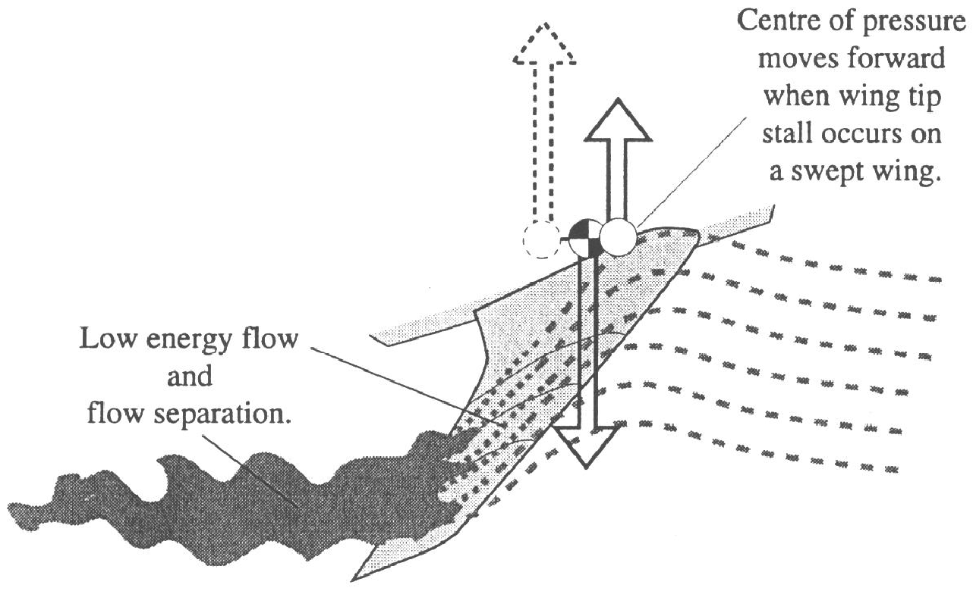
Disadvantages of swept wings. Tip stall
Notes:
‹#›
The low-speed and high-speed limits for a given jet aircraft can be found in the stall and buffet onset diagram as shown. The upper curved lines represent altitude or flight level. Where these curves are pointed up to the left they represent high-speed buffeting, while where the curve points to the lower left they represent the low-speed buffeting. In this diagram, only the stalling speeds for zero flap at sea level are shown. At the lower part of the diagram the actual gross weight and angle of bank are noted.
From this graph the stalling speed (V_{stall}), the speed limit for low-speed buffet and the speed where the high-speed buffeting starts for a given weight and bank angle, can be found. The procedure is: follow the guidelines downward from the actual gross weight, (17.5 ton) to the horizontal line through the angle of bank of 40°. From this intersection, straight up to the actual flight level curve 350 (35.000 ft). That gives the following speeds; (V_{stall}), stalling speed (zero flap) 135 KIAS, low-speed buffet at 148 KIAS and high-speed buffet at 283 KIAS.

Slide 30
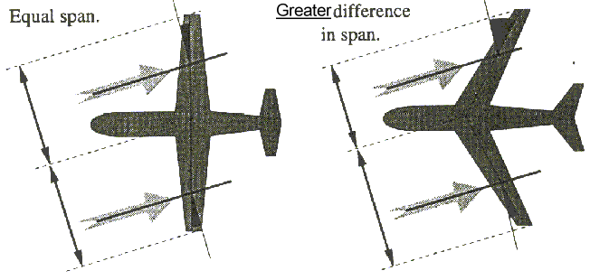
Disadvantages of swept wings. Sideslip characteristics

Slide 31
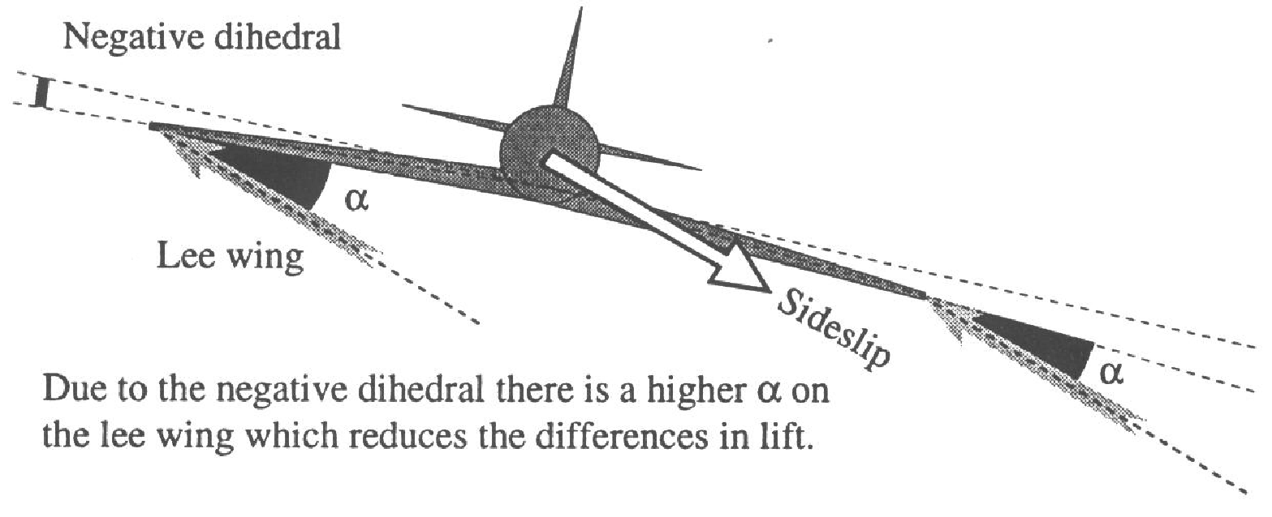
Disadvantages of swept wings. Sideslip characteristics
Notes:
‹#›
Designing aircraft is always a matter of compromise. Design features that are good for low-speeds are usually not as good for high speeds and vice versa. For instance a swept wing will have good high-speed qualities at relatively high critical Mach numbers, while it will have some disadvantages at low speeds.
The swept wing creates less lift and more drag at a given angle of attack than a straight wing in all low speed cases. When the wing is swept, a higher angle of attack is needed in order to create the same lift coefficient. These factors cause greater induced drag.
At transonic speeds however a swept wing still produces less lift than a straight wing, but also less drag. The higher induced drag of the swept wing is more than offset by the reduced wave drag of the swept wing in the transonic speed range.

Slide 32
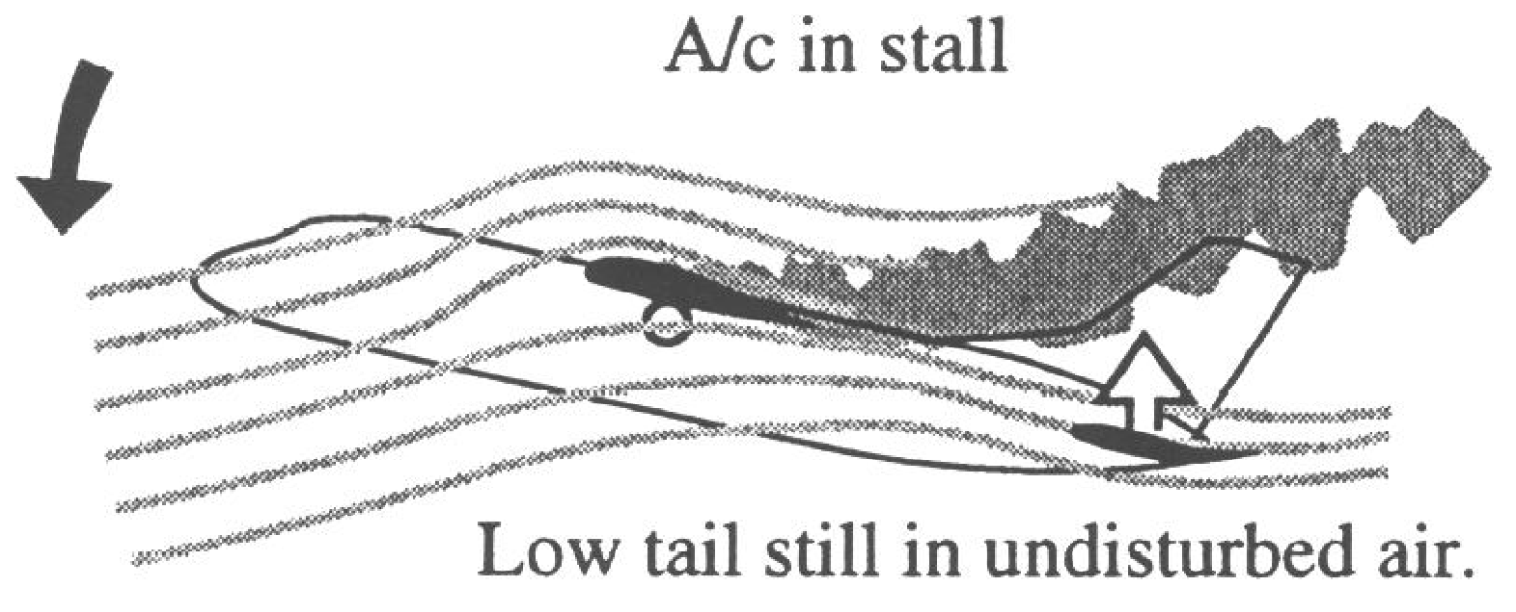
Disadvantages of a T-tail.
Notes:
‹#›
Another disadvantage of highly swept wings is the possibility of going into deep stall or a locked-in situation. A contributing factor to deep stall is the wing tip stall of the main wing.
With swept wings at, the relative airflow will flow towards the lower pressure area further back and out near the wing tips. This will make the boundary layer very long with low energy flow near the wing tips.
This low energy flow will separate earlier at a lower angle of attack than the flow closer to the wing root, which is located further forward. The centre of pressure will thus move forward, causing a pitch-up.
As the angle of sweep of a wing increases, the pitch-up becomes an important factor in stall development.
The initial flow separation may start at the wing tips, well before the actual stall has been reached, and the aircraft may pitch up so rapidly that it may be impossible to stop the rotation before a deep stall has been reached.
However, this behaviour is not acceptable for a certified aircraft. In such cases, an artificial device such as stick shaker or stick pusher has to be installed to limit the max allowable angle of attack.

Slide 33
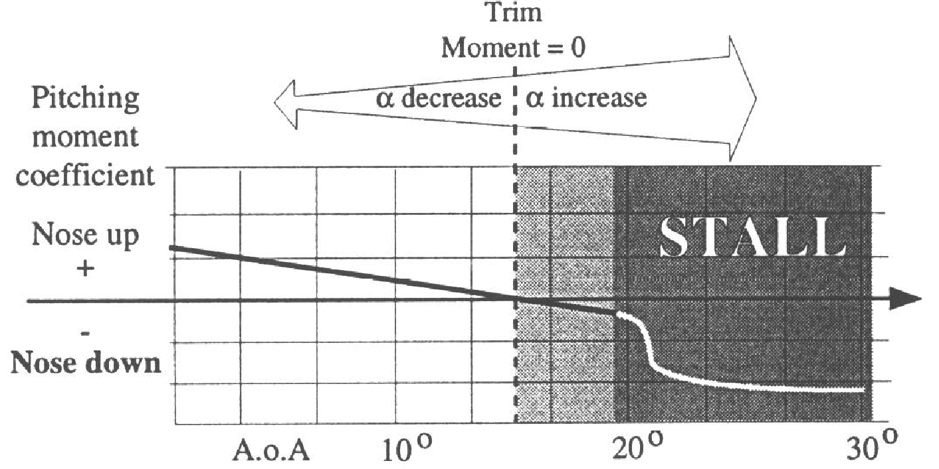
Disadvantages of a T-tail.
Notes:
‹#›
Another disadvantage of a highly swept wing is its sideslip characteristics. A straight wing can side slip considerably without getting out of control. A swept wing, however, due to the strong yaw-roll coupling, may rapidly roll to the lee side of the sideslip.
When sideslipping, the difference in lift between the forward pointing wing (on the windward side) and the aft pointing wing (lee wing) is caused by the difference in the actual span facing the relative free stream flow.
When the sideslip is deliberately maintained, the rolling moment upwards is compensated for by the use of the ailerons to the other side. But there is a risk. The longer boundary layer over the lee wing creates a low energy flow over the aileron.
The low energy boundary layer over the down going aileron will cause that wing to stall much earlier than the windward wing. This asymmetrical stall may cause an uncontrolled snap roll.

Slide 34
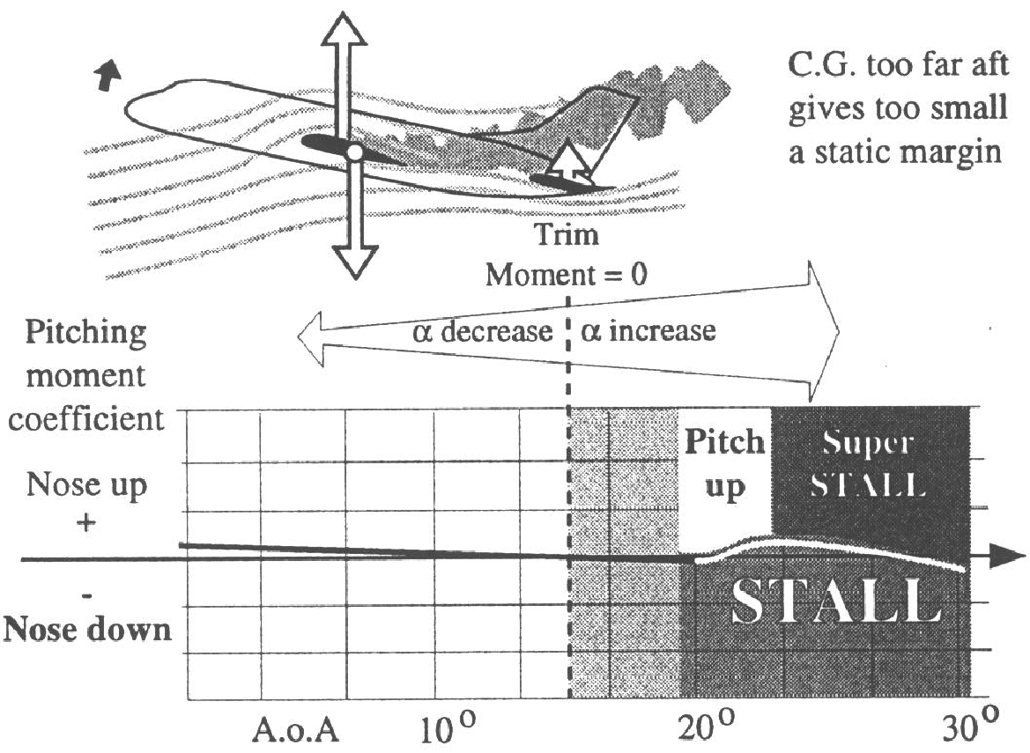
Disadvantages of a T-tail.
Notes:
‹#›
One way to reduce the loss of lift from the aft pointed wing is to design the aircraft with a negative dihedral, also known as anhedral. With a negative dihedral the lee wing will have a slightly higher A.o.A. than the windward wing, making the difference in lift less prominent.

Slide 35
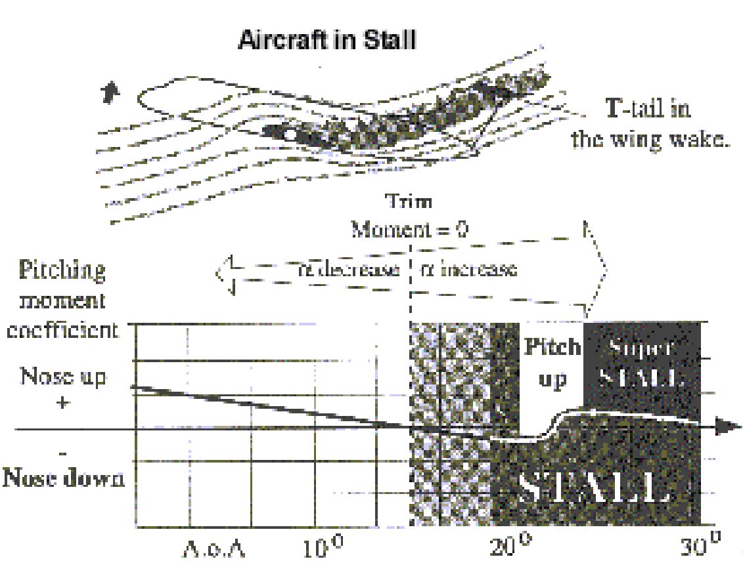
Disadvantages of a T-tail.
Notes:
‹#›
When properly balanced, an aircraft with straight wings and a low tail (compared to the wing plane) is stable and will lower its nose and recover from the stall without any problems. When in the stalled condition, the wing wake passes more or less straight aft and flows above the low tail.
This leaves the tail working in crisp high energy air where it experiences a sharp increase in positive incidence, causing upward lift. This lift then assists the nose down pitch of the whole aircraft and a deep stall condition is avoided.

Slide 36
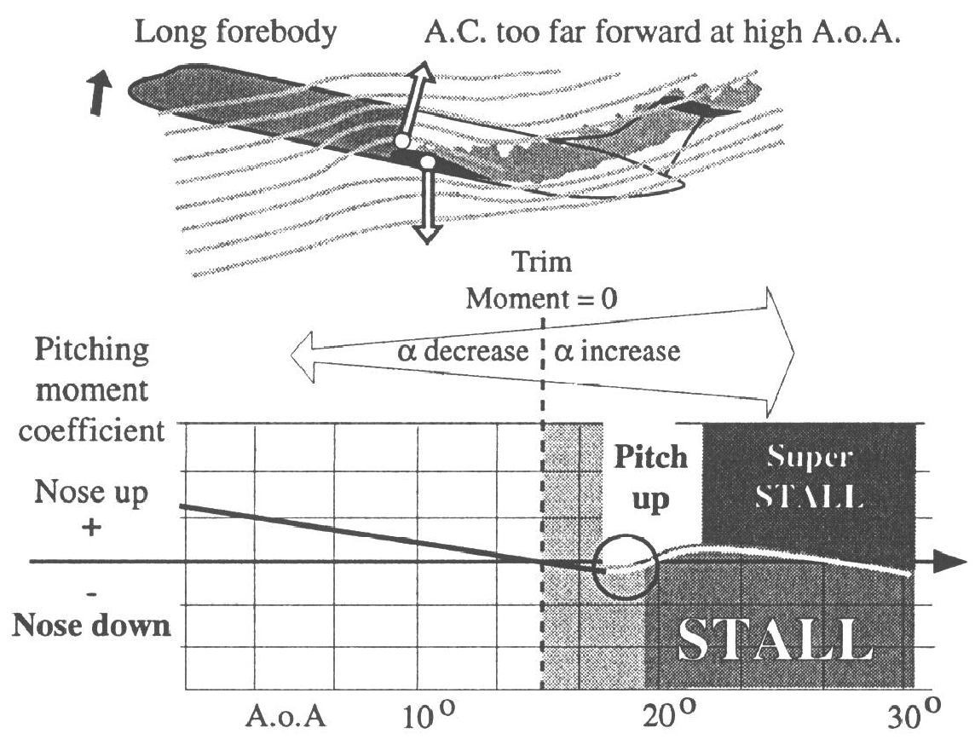
Disadvantages of a T-tail.
Notes:
‹#›
This moment graph shows a more or less stable aircraft at all angles of attack. You can see that an increase in the angle of attack will give a greater or lesser increase in the nose down moment, also in a stalled condition. The nose down moment will tend to reduce the angle of attack, making the aircraft stable.
The following moment curves are not actual ones but have been drawn in order to better illustrate the effect.

Slide 37
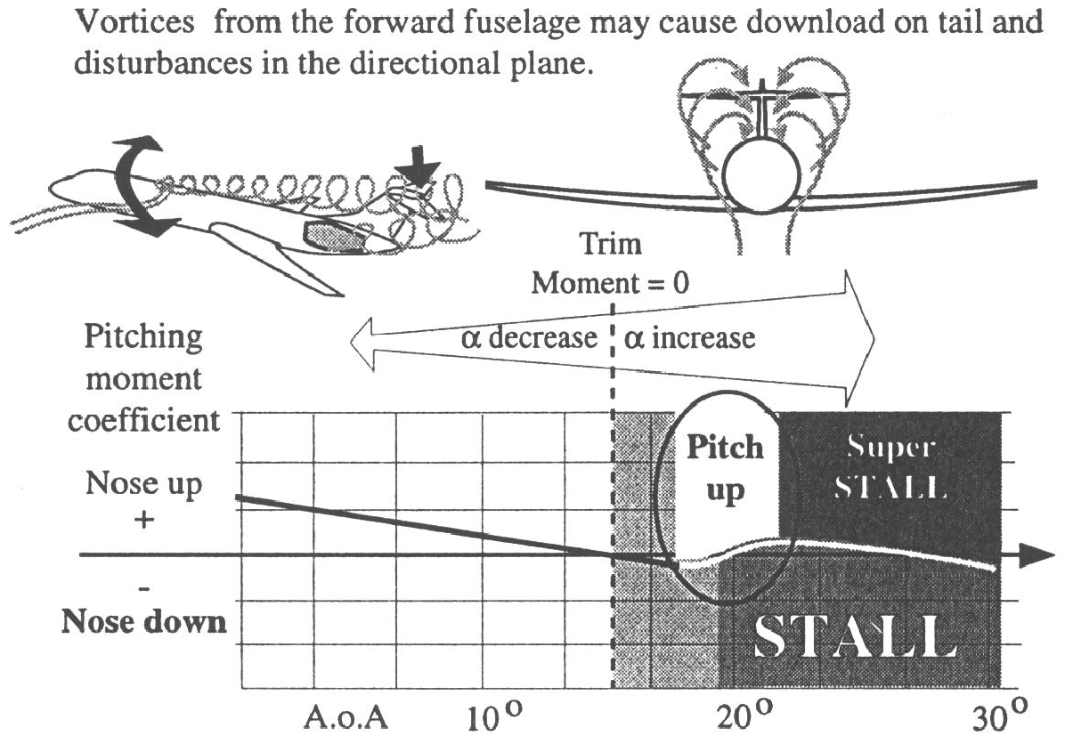
Disadvantages of a T-tail.
Notes:
‹#›
However, aircraft with mid tail or high tail may be unstable in certain conditions at high angles of attack, for instance when the centre of gravity is too far aft. This will make the moment curve flatter, and the loss of lift at the trailing edge near and in the stall, together with the downwash over the tail, causes a pitch-up instead of a pitch down.

Slide 38
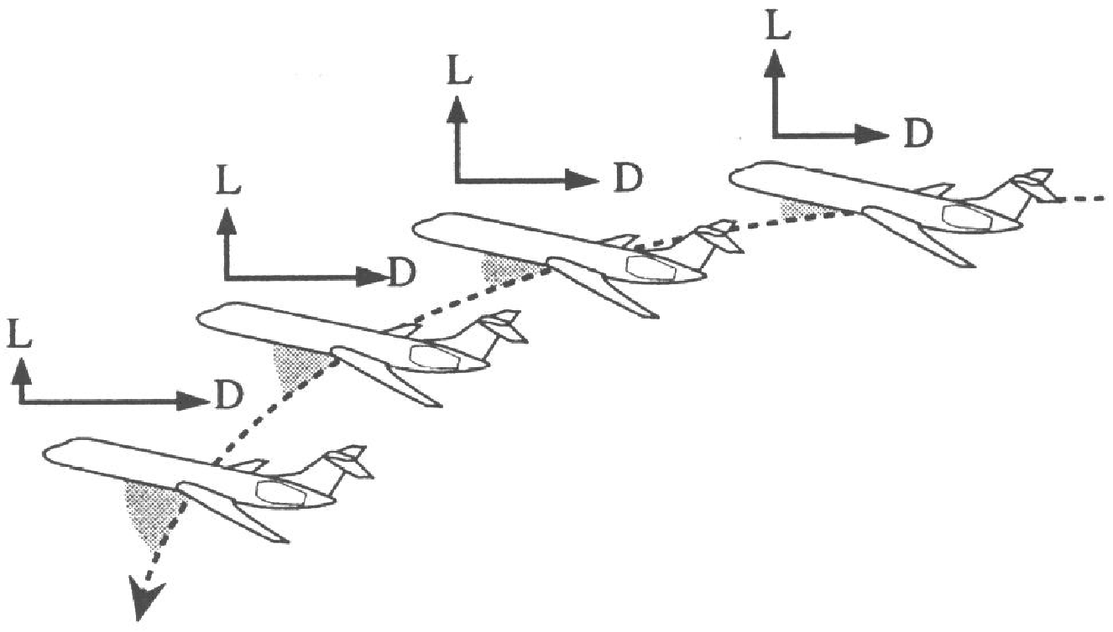
Superstall
Notes:
‹#›
An aircraft may go into a locked situation called deep stall or a super stall. However, an aircraft with T-tail may go into a deep stall or locked situation despite having a normal centre of gravity. It is possible that the tail will be in the wing and fuselage wake during the stall and consequently lose the pitch down capacity necessary for recovery.

Slide 39
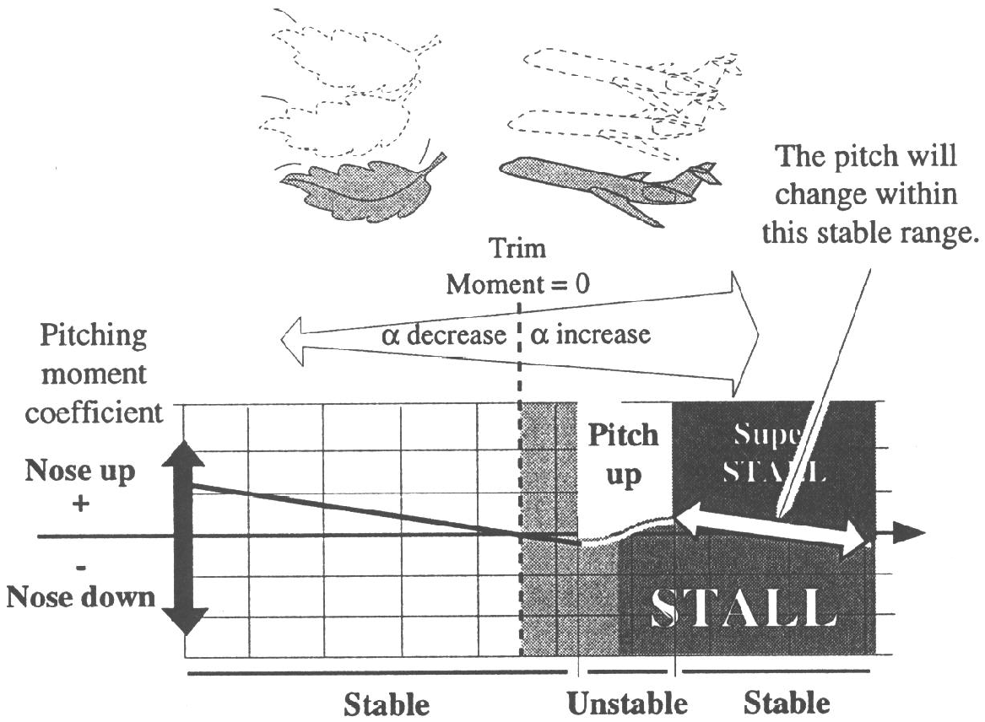
Superstall
Notes:
‹#›
In addition, a T-tailed aircraft with a long slim fuselage can make the condition worse. At high angle of attack the fore body itself may cause a pitch-up before the stall and flatten the moment curve when in the stall.
A long slim fuselage at a high angle of attack changes the surrounding airflow like a wing with an extremely high angle of sweep. When the fuselage reaches a certain angle of attack, the flow separates into vortices above the body which may reach the horizontal tail. These vortices may push the tail downwards, rapidly increasing the angle of attack into a deep stall, but also causing directional disturbances.

Slide 40
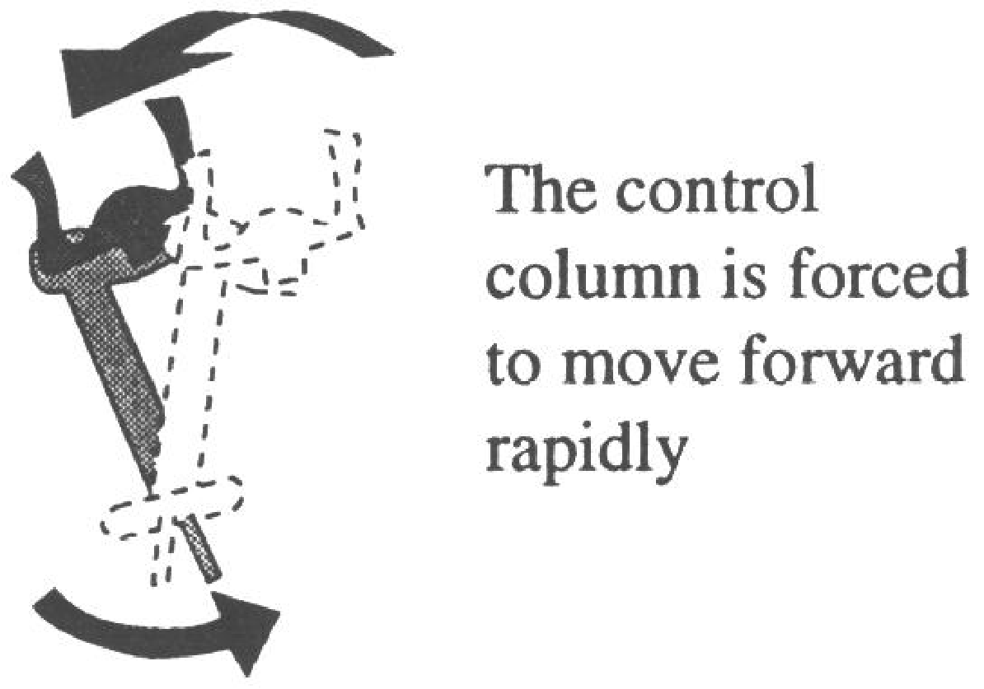
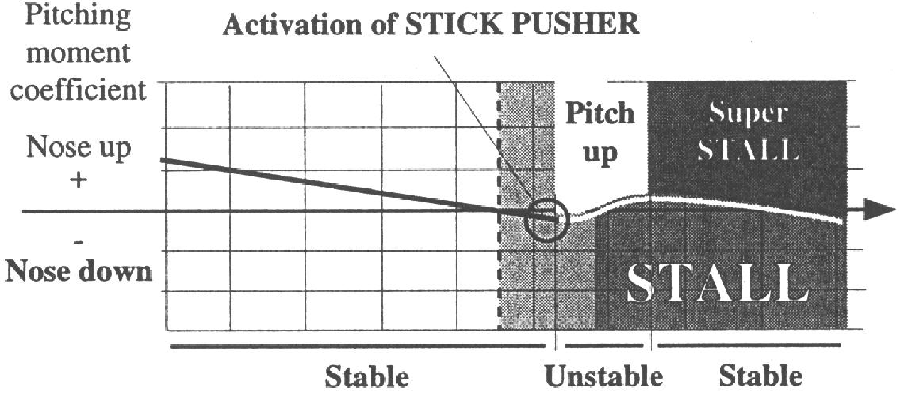
Stick shakers/pushers.
Notes:
‹#›
This shows a typical flow picture of what may happen to aircraft with long fore bodies, such as those with engines mounted aft on the fuselage.
Going into a deep stall may be the result of a combination of wing tip stall, long fore body and aft mounted engines. If the downwash becomes great enough, the downward force on the stabiliser cannot be counteracted by full downward elevator deflection. The aircraft then becomes locked at a high angle of attack that rapidly leads to a deep stall condition.
In addition, the airflow through aft mounted engines would be disturbed, possibly to the point of a flameout.

Slide 41
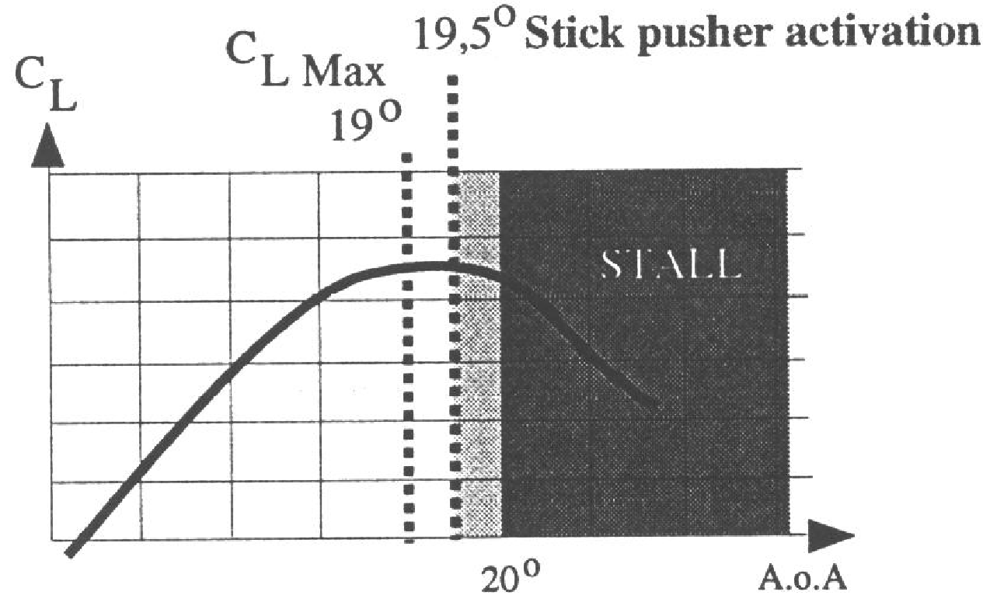
Stick shakers/pushers
Notes:
‹#›
When being locked into a high angle of attack, a further increase in the angle of attack causes the drag to increase faster than the lift, and the aircraft decelerates rapidly and sinks.

Slide 42
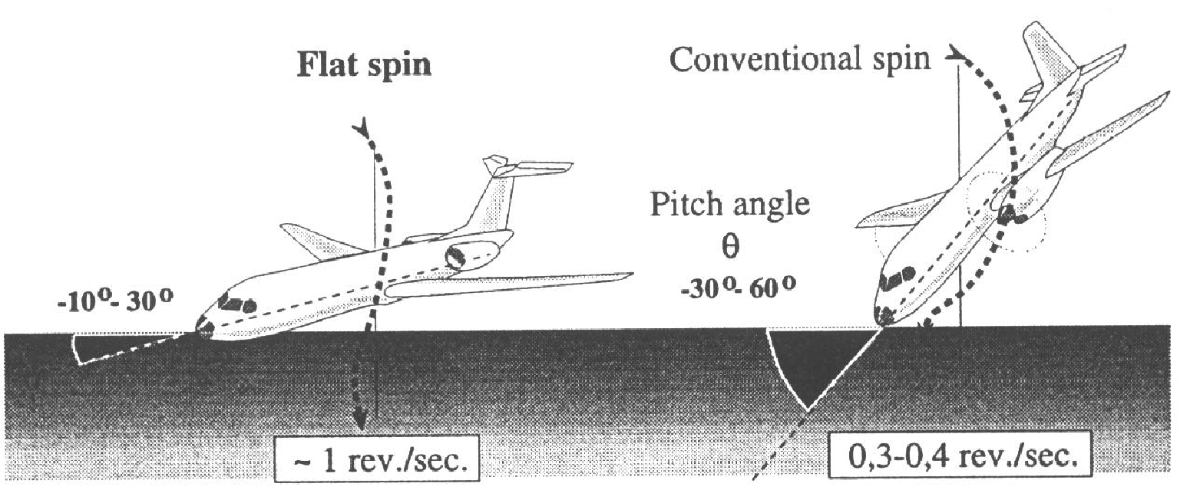
Spin characteristics.
Notes:
‹#›
The increasing tendency to sink at almost constant pitch attitude results in a rapid increase in the angle of attack as the descending flight path steepens. Once the stall has developed and most of the lift has been lost, the aircraft will start to sink rapidly; this is accompanied by a further rapid increase in the angle of attack. In superstall, the flight controls are completely useless when trying to control the aircraft.
A closer look at the moment curve of the area for superstall shows that the aircraft will be in a stable situation. An increase in the angle of attack will cause a nose down moment, reducing the angle of attack again. When the A.o.A has been reduced, it will cause a nose up moment which increases the angle of attack again etc. In such condition the aircraft will fall like an autumn leaf changing slightly in pitch.
How to avoid super stall.
Since wing tip stall on an aircraft with swept wings may put the aircraft into a deep stall, it is necessary to avoid it. Therefore, aircraft with highly swept wings may have devices to minimise the flow separation near the wing tips. These devices are: boundary layer fences / vortex generators on the upper / leading surfaces of the wings, and possibly “saw-teeth” leading edges.

Slide 43
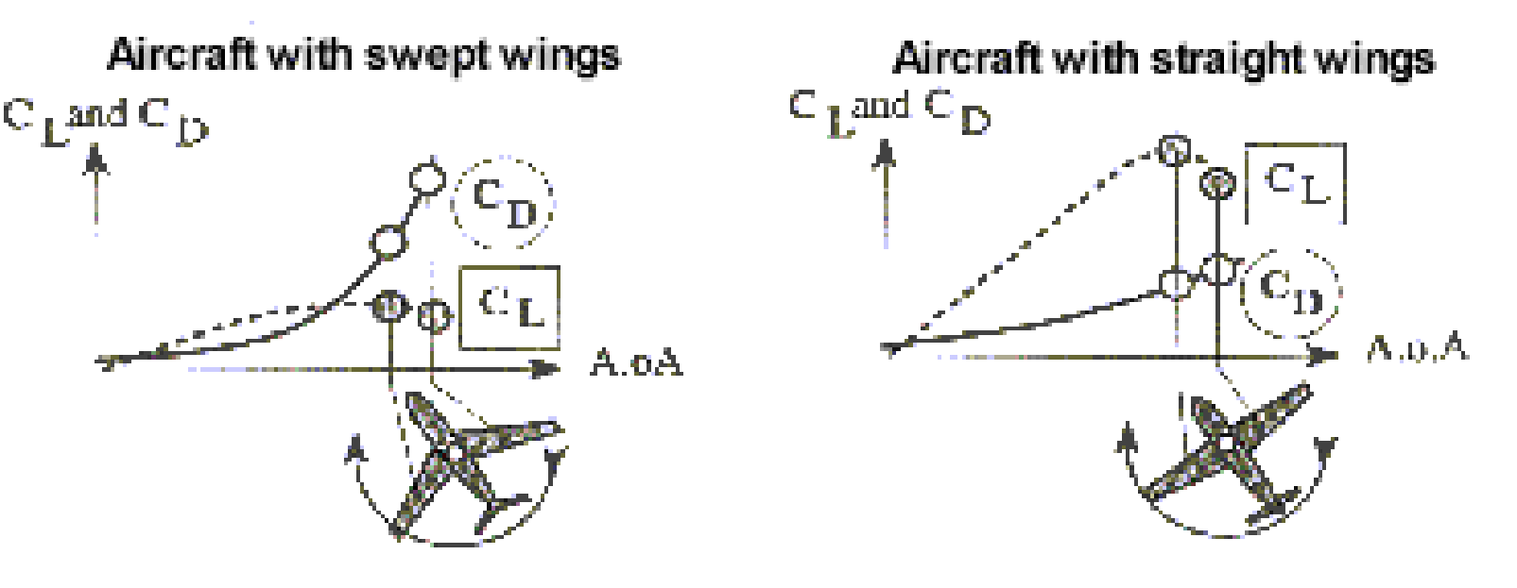
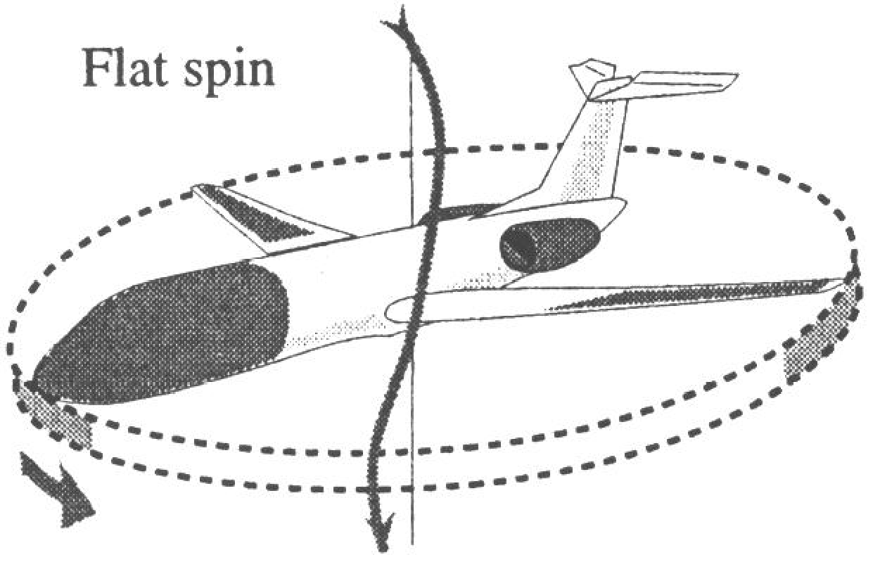
Spin characteristics.
Notes:
‹#›
When an aircraft has failed to meet the stalling requirements by normal aerodynamic means such as use of fences or boundary layer control devices, that is; the natural stall is quite unacceptable, it may be equipped with a stick-shakers and pushers.
The stick shaker consists of an electrically driven weight on the control column which is activated automatically at a preset angle of attack depending upon the aircraft configuration. The weight shakes the control column giving a tactile warning of the onset of an approaching stall condition.
In most jet transport aircraft, the engine auto-ignition system will also be activated to relight the engine should the high angle of induced intake turbulence cause an engine flameout.
Should the pilot continue to increase the angle of attack, the stick pusher pushes the stick or the control column forward in order to avoid the stall by reducing the angle of attack before a pitch-up or deep stall is reached.
This device must provide a clear and unmistakable identification of the stall by a sharp positive forward movement of the control column and an adequate nose down pitch of the aircraft.
The sharpness of the push is necessary for identifying the stall instantly because a slow push might make the pilot pull too far into the deeper area. The impetus and duration of the push is tailored to give a good positive recovery manoeuvre in all configurations, all positions of the CG and from varying rates of entering stall.

